Slide 1
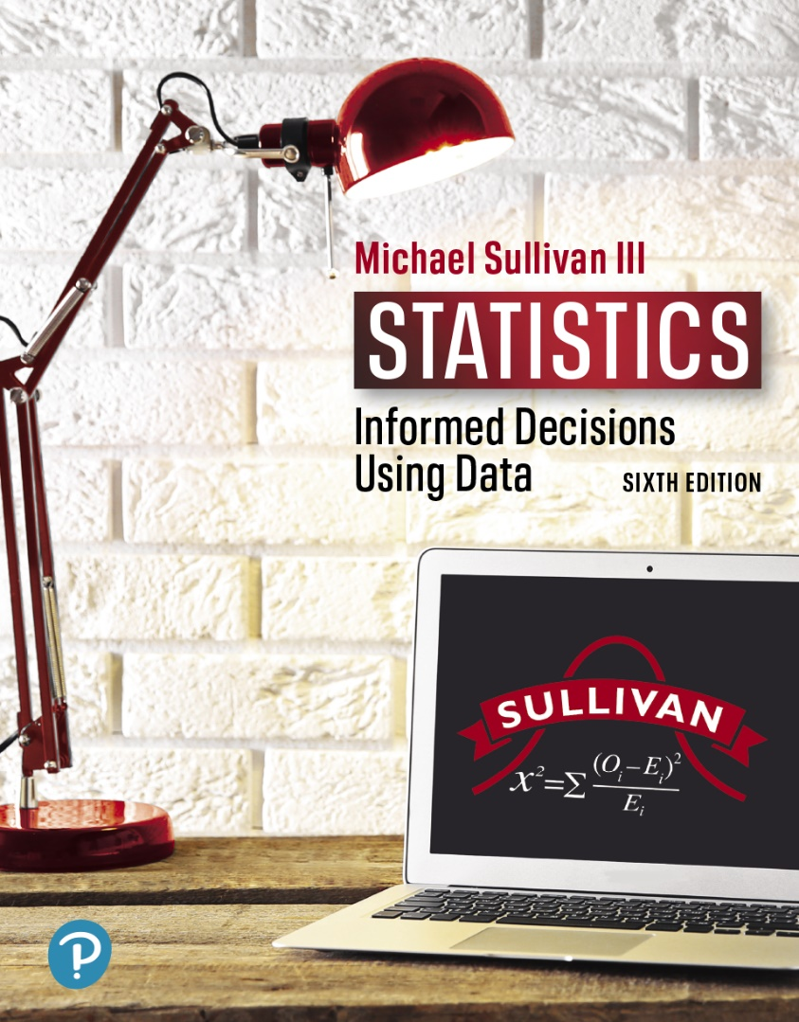
STATISTICS
INFORMED DECISIONS USING DATA
Chapter 14
Inference on the Least-Squares Regression Model and Multiple Regression
14-1

Slide 2

14.1 Testing the Significance of
the Least-Squares
Regression Model
Learning Objectives
State the requirements of the least-squares regression model
Compute the standard error of the estimate
Verify that the residuals are normally distributed
Conduct inference on the slope of the least-squares regression model
Construct a confidence interval about the slope of the least-squares regression model
14-2

Slide 3
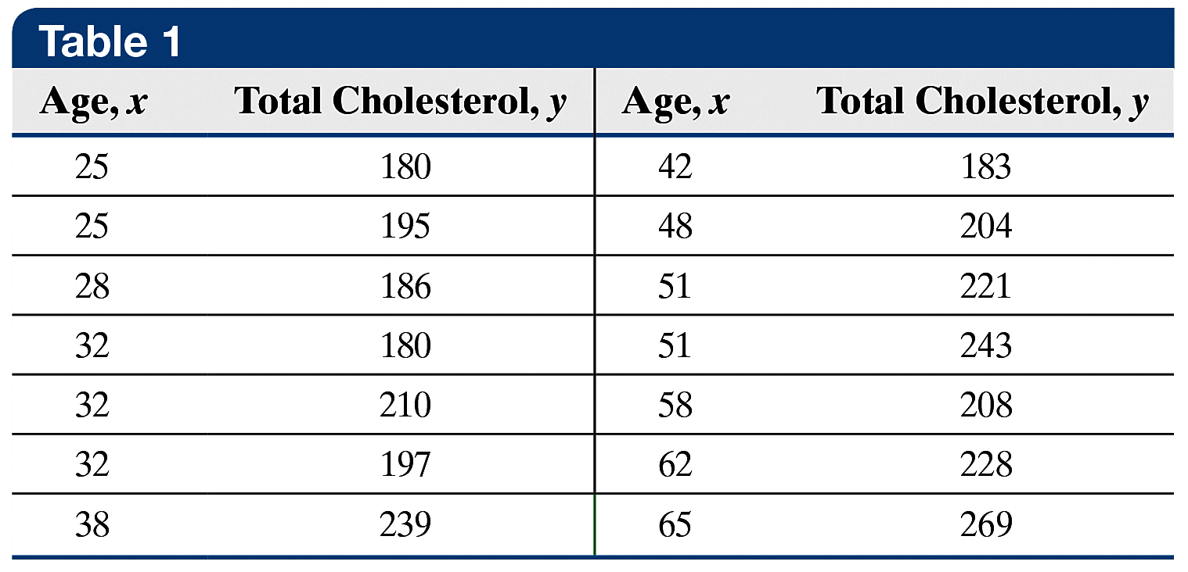
EXAMPLE Least-Squares Regression
(1 of 4)
A family doctor is interested in examining the relationship between a patient’s age and total cholesterol (in mg/dL). He randomly selects 14 of his female patients and obtains the data presented in Table 1.
14-3

Slide 4
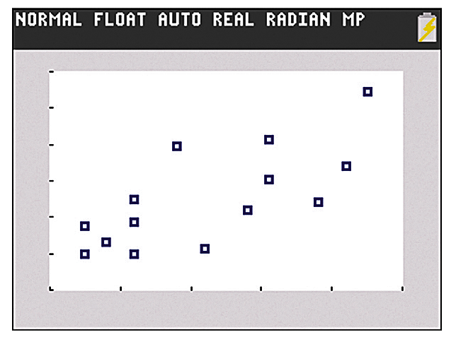
EXAMPLE Least-Squares Regression
(2 of 4)
The data are based on results obtained from the National Center for Health Statistics. Draw a scatter diagram, compute the correlation coefficient, find the least squares regression equation, and determine the coefficient of determination.
Figure (a) displays the
scatter diagram.
(a)
14-4

Slide 5
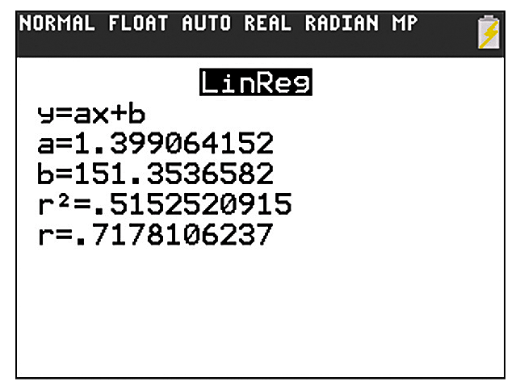


EXAMPLE Least-Squares Regression
(3 of 4)
Figure (b) displays the output.
The linear correlation coefficient is 0.718. The least-squares regression equation for these data is
where represents the predicted total cholesterol for a female whose age is x.
(b)
14-5

Slide 6
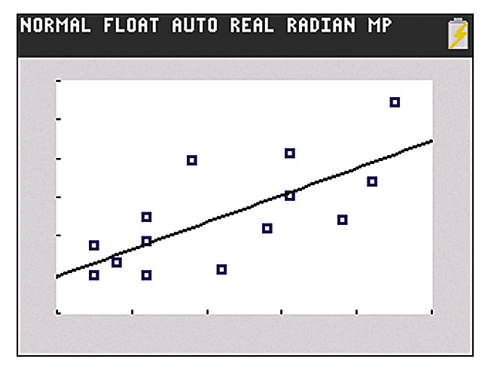
EXAMPLE Least-Squares Regression
(4 of 4)
The coefficient of determination, R², is 0.515, so 51.5% of the variation in total cholesterol is explained by the regression line.
Figure (c) shows a graph of the least-squares regression equation on the scatter diagram.
(c)
14-6

Slide 7
Objective 1
State the Requirements of the Least-Squares Regression Model
14-7

Slide 8

Requirement 1 for Inference on the Least-Squares Regression Model
For any particular value of the explanatory variable x, the mean of the corresponding responses in the population depends linearly on x. That is,
for some numbers β₀ and β₁, where μ_{y|x} represents the population mean response when the value of the explanatory variable is x.
14-8

Slide 9
Requirement 2 for Inference on the Least-Squares Regression Model
The response variable is normally distributed with mean and standard deviation σ.
14-9

Slide 10
In Other Words
When doing inference on the least-squares regression model, we require (1) for any explanatory variable, x, the mean of the response variable, y, depends on the value of x through a linear equation, and (2) the response variable, y, is normally distributed with a constant standard deviation, σ. The mean increases/decreases at a constant rate depending on the slope, while the standard deviation remains constant.
14-10

Slide 11
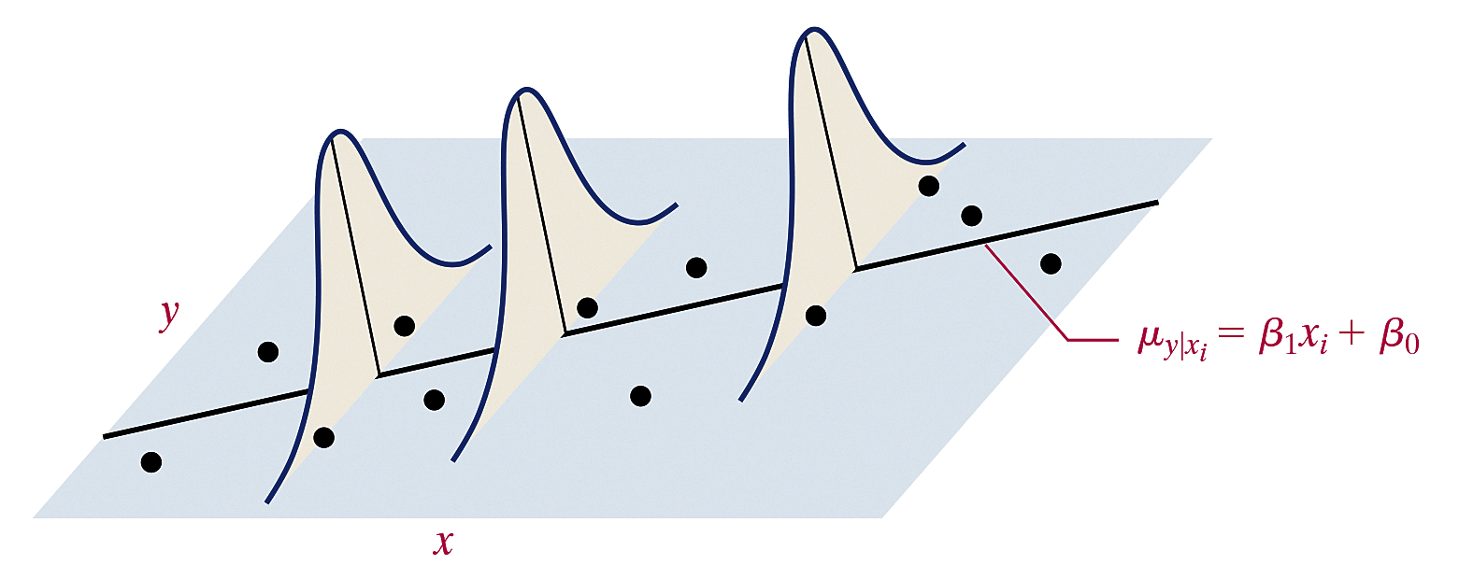
A large value of σ, the population standard deviation, indicates that the data are widely dispersed about the regression line, and a small value of σ indicates that the data lie fairly close to the regression line.
14-11

Slide 12

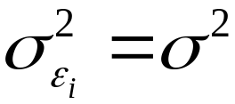
The least-squares regression model is given by
where
  y_{i} is the value of the response variable for the i^{th}
  individual
  x_{i} is the value of the explanatory variable for the i^{th}
  individual
  β₀ and β₁ are the parameters to be estimated based
  on sample data
  ε_{i} is a random error term with mean 0 and standard
  deviation ; the error terms are
  independent.
  i =1,…,n, where n is the sample size (number of
  ordered pairs in the data set)
(1)
14-12

Slide 13
Objective 2
Compute the Standard Error of the Estimate
14-13

Slide 14
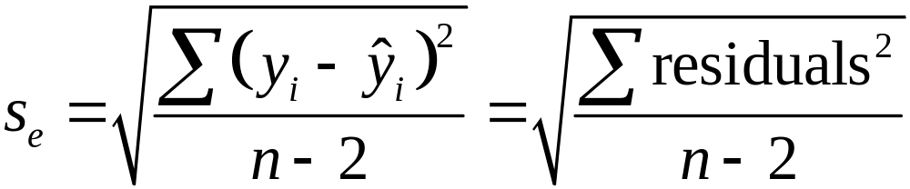
The standard error of the estimate, s_{e}, is found using the formula
(2)
14-14

Slide 15
EXAMPLE Computing the Standard Error by Hand
(1 of 4)
Compute the standard error of the estimate for the data in Table 1.
14-15

Slide 16

EXAMPLE Computing the Standard Error by Hand
(2 of 4)
Step 1 In the previous example, the least-squares regression was
Step 2 Column 3 of Table 2, shown on the next slide, shows the predicted values for the n = 14 observations.
Step 3 Column 4 of Table 2 shows the residuals for the 14 observations.
14-16

Slide 17
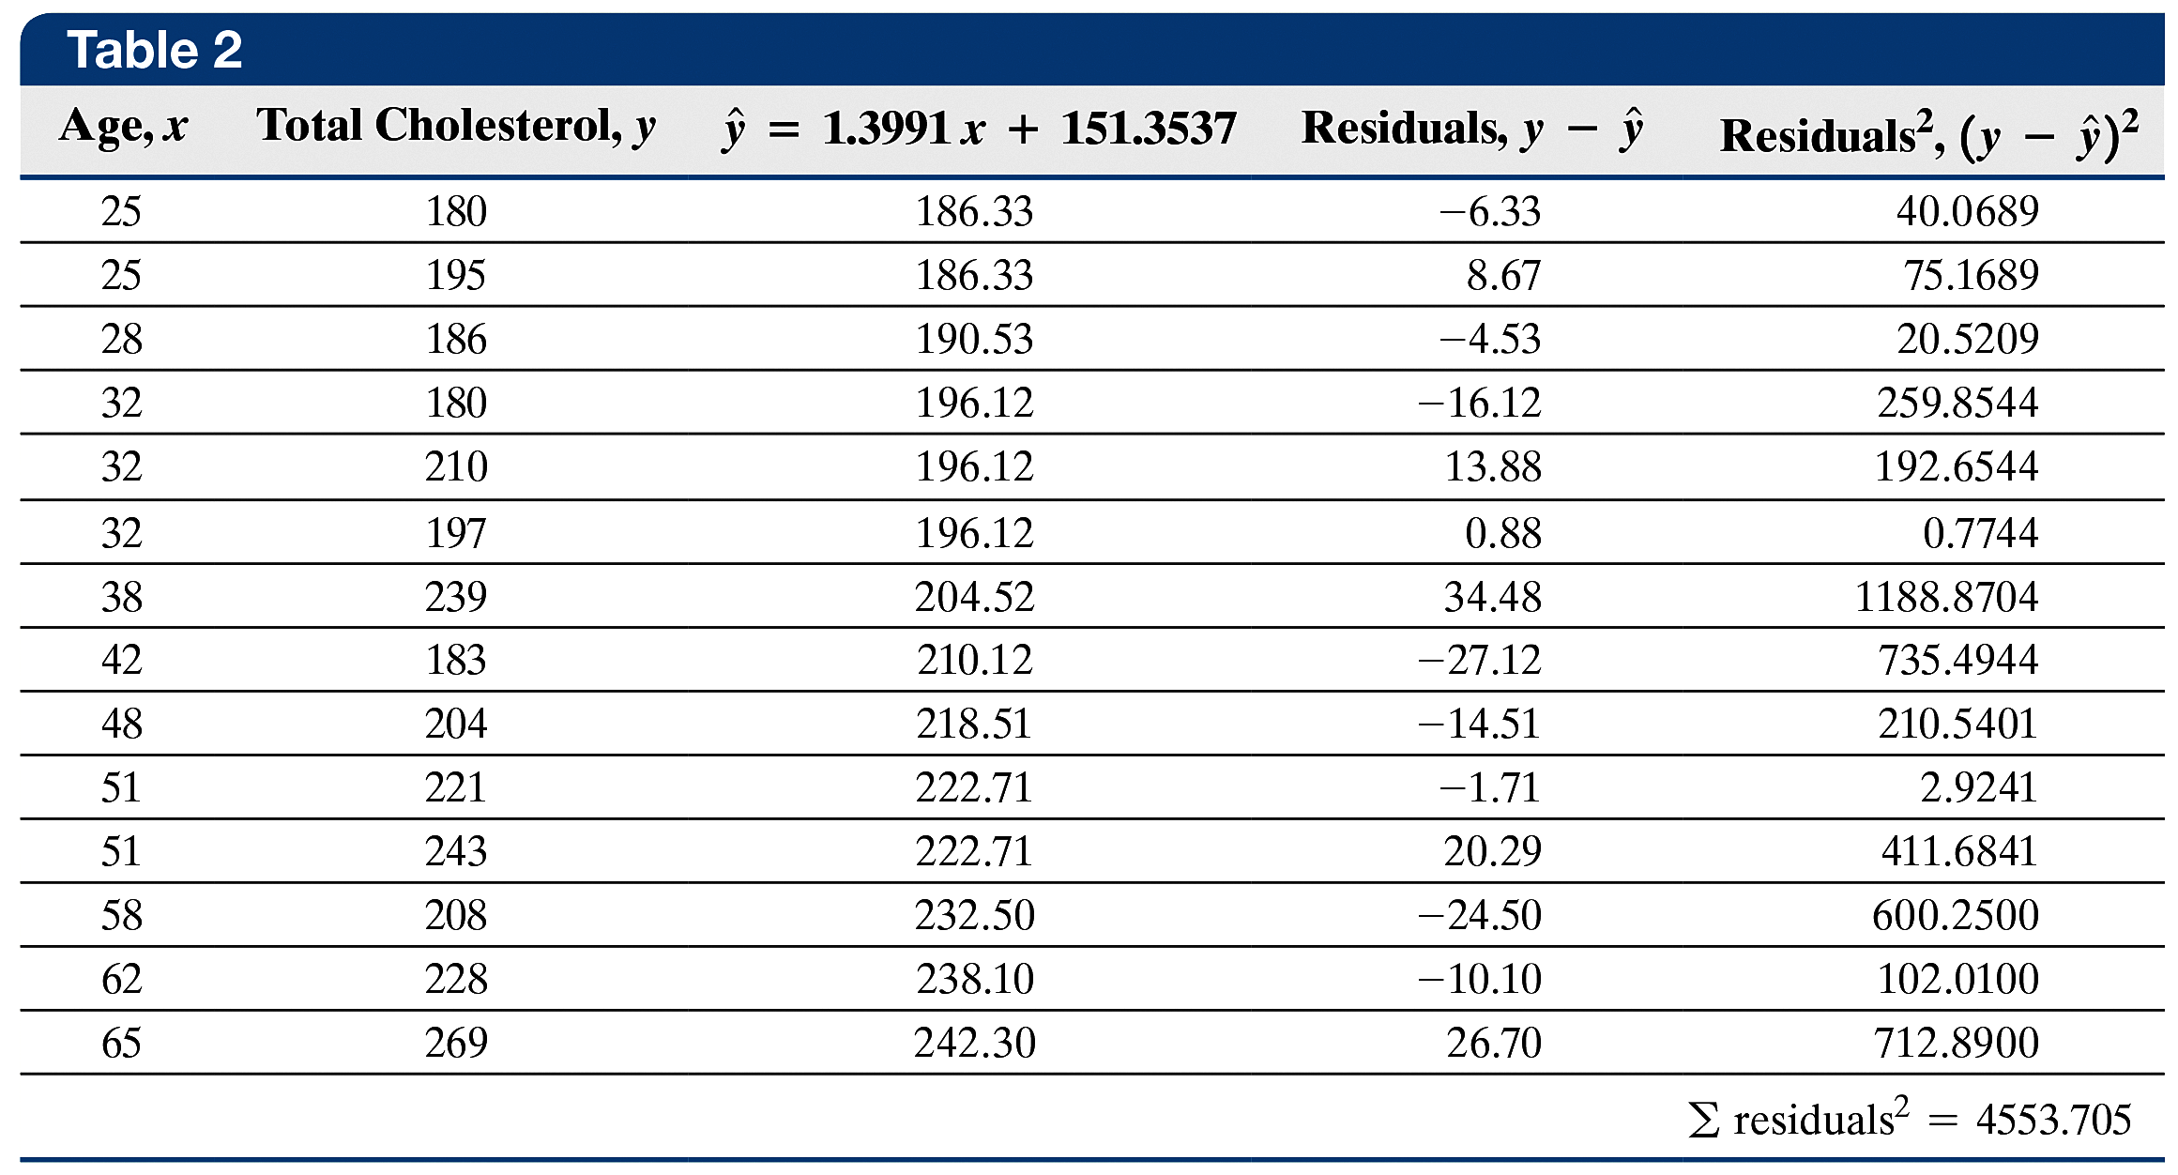
EXAMPLE Computing the Standard Error by Hand
(3 of 4)
14-17

Slide 18
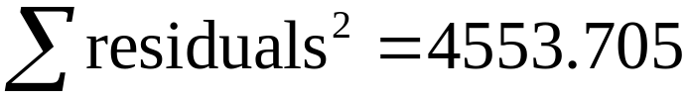
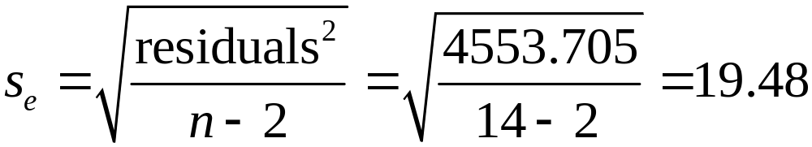
EXAMPLE Computing the Standard Error by Hand
(4 of 4)
Step 4 Sum the squared residuals in column 5 to find the sum of squared errors:
Step 5 Use Formula (2) to compute the standard error of the estimate.
14-18

Slide 19
CAUTION!
Be sure to divide by n – 2 when computing the standard error of the estimate.
14-19

Slide 20
EXAMPLE Obtaining the Standard Error of the
(1 of 2) Estimate Using Technology
Obtain the standard error of the estimate for the data in Table 1 using statistical software.
14-20

Slide 21
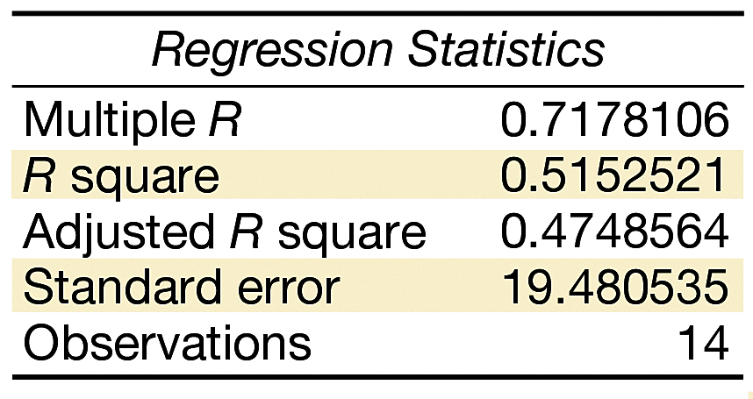
EXAMPLE Obtaining the Standard Error of the
(2 of 2) Estimate Using Technology
The figure shows the partial output from Excel. The results agree with the by-hand computation.
14-21

Slide 22
Objective 3
Verify That the Residuals Are Normally Distributed
14-22

Slide 23
EXAMPLE Verifying That the Residuals Are Normally
(1 of 2) Distributed
Verify that the residuals obtained in Table 2 from a previous example are normally distributed.
14-23

Slide 24
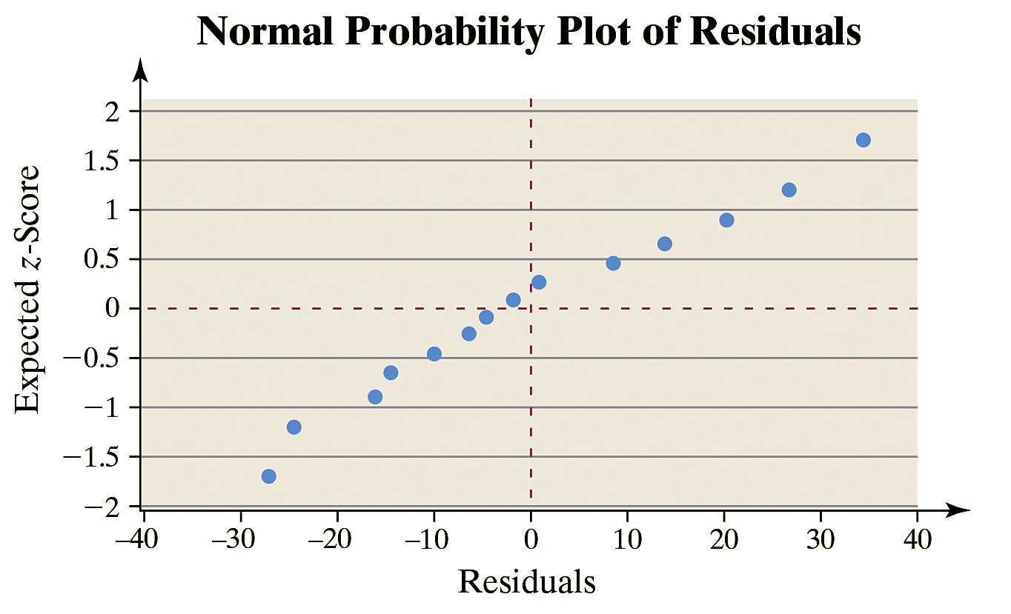
EXAMPLE Verifying That the Residuals Are Normally
(2 of 2) Distributed
The figure contains the normal probability plot. The correlation between the residuals and expected z-scores is 0.988. Because
0.988 > 0.935 (Table VI), it is reasonable to conclude the residuals are normally distributed. Therefore, we can perform inference on the least-squares regression equation.
14-24

Slide 25
Objective 4
Conduct Inference on the Slope of the Least-Squares Regression Model
14-25

Slide 26
Hypothesis Test Regarding the Slope Coefficient, β₁
To test whether two quantitative variables are linearly related, we use the following steps provided that
The sample is obtained using random sampling or from a randomized experiment.
The residuals are normally distributed with constant error variance.
14-26

Slide 27
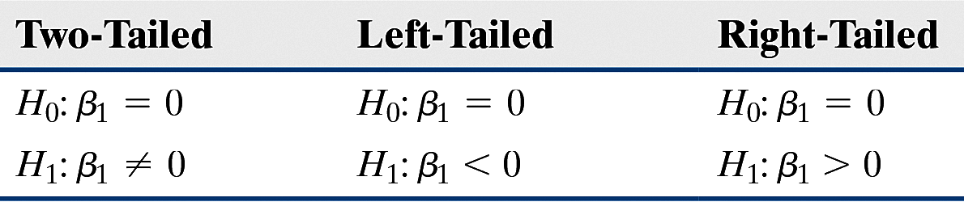
Hypothesis Test Regarding the Slope Coefficient, β₁
Step 1 Determine the null and alternative hypotheses. The hypotheses can be structured in one of three ways:
Step 2 Select a level of significance, α, depending on the seriousness of making a Type I error.
14-27

Slide 28
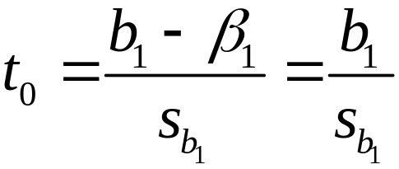
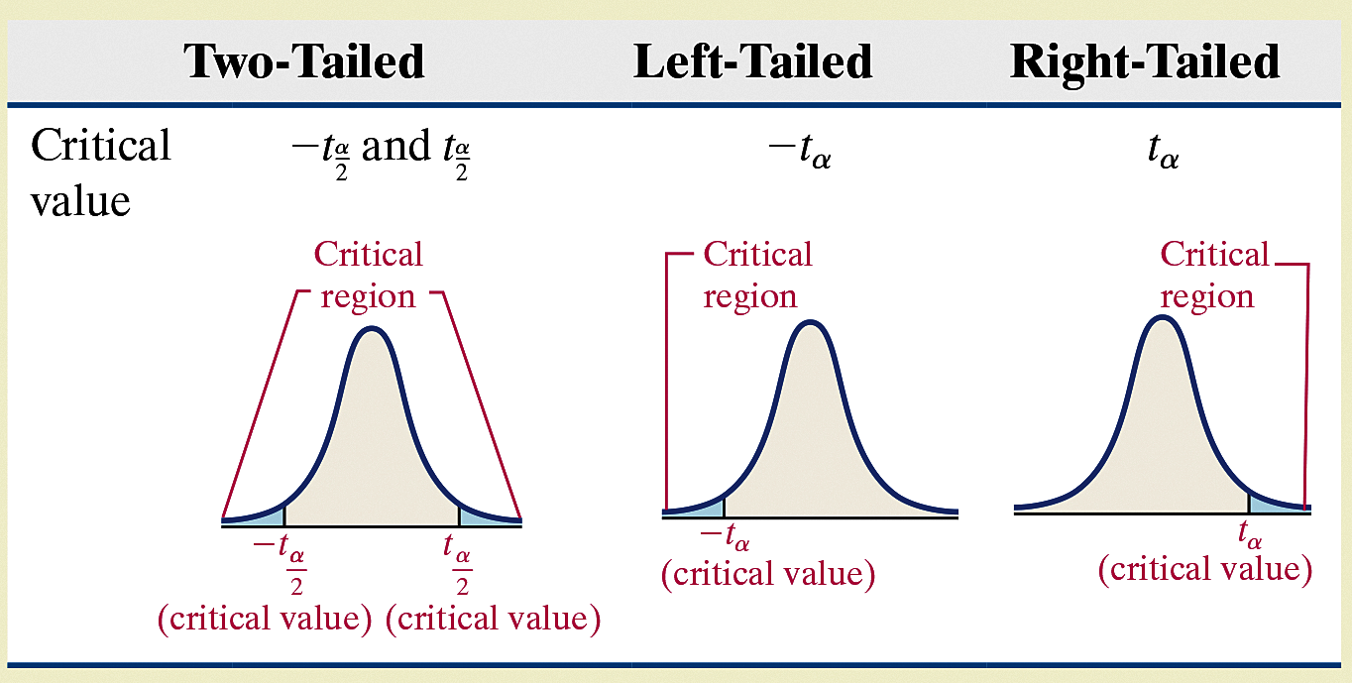
Hypothesis Test Regarding the Slope Coefficient, β₁
Classical Approach
Step 3 Compute the test statistic
which follows
Student’s t-distribution
with n – 2 degrees of
freedom. Use Table
VII to determine the
critical value.
14-28

Slide 29
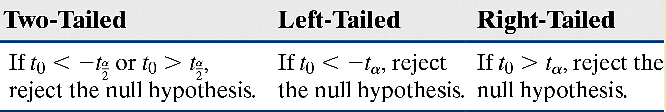
Hypothesis Test Regarding the Slope Coefficient, β₁
Classical Approach
Step 4 Compare the critical value to the test statistic.
Step 5 State the conclusion.
14-29

Slide 30
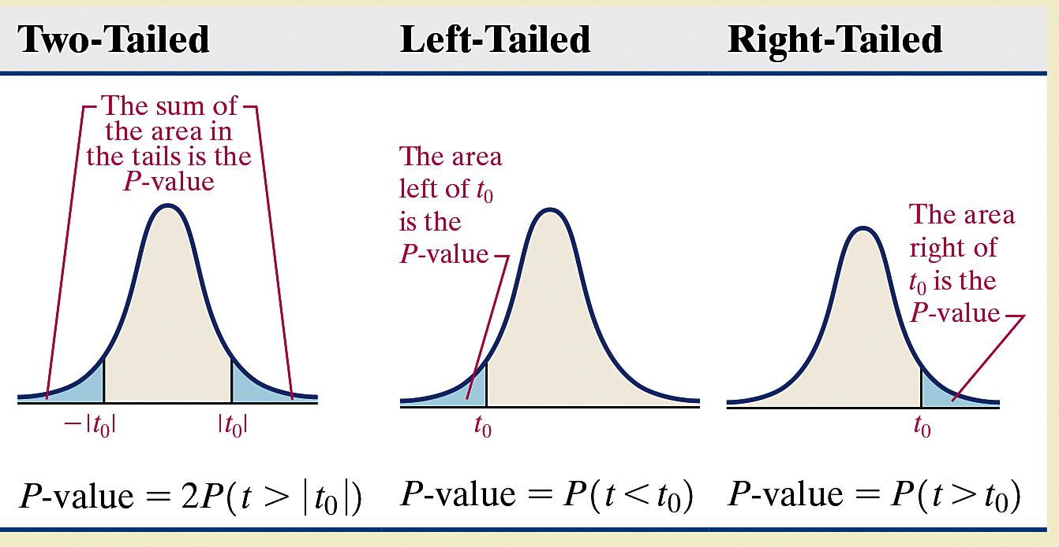
Hypothesis Test Regarding the Slope Coefficient, β₁
P-Value Approach
By-Hand Step 3
Compute the test statistic
which follows
Student’s t-distribution
with n – 2 degrees of
freedom. Use Table
VII to approximate
the P-value.
14-30

Slide 31
Hypothesis Test Regarding the Slope Coefficient, β₁
P-Value Approach
Technology Step 3 Use a statistical spreadsheet or calculator with statistical capabilities to obtain the P value.
Step 4 If P-value < α, reject the null hypothesis.
Step 5 State the conclusion.
14-31

Slide 32
CAUTION!
Before testing H₀: β₁ = 0, be sure to draw a residual plot to verify that a linear model is appropriate.
14-32

Slide 33
EXAMPLE Testing for a Linear Relation
(1 of 11)
Test whether a linear relation exists between age and total
cholesterol at the α = 0.05 level of significance using the data in Table 1 from a previous example.
14-33

Slide 34
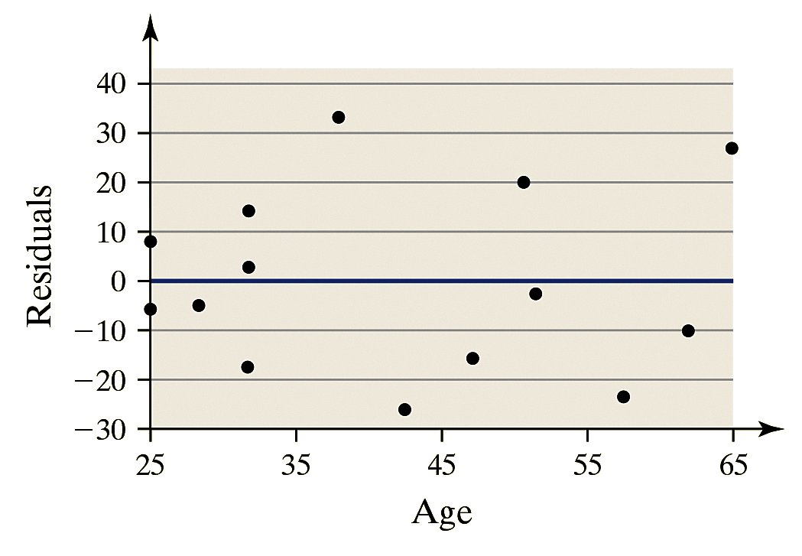
EXAMPLE Testing for a Linear Relation
(2 of 11)
In a previous example, we were told that the individuals were randomly selected. In a later example, we confirmed that the residuals are normally distributed.
Verify the requirement of constant error variance by plotting the residuals against the values of the explanatory variable as shown in the figure.
The errors are evenly spread
around a horizontal line
drawn at 0, so the
requirement of constant error
variance is satisfied.
Now follow Steps 1 through 5.
14-34

Slide 35
EXAMPLE Testing for a Linear Relation
(3 of 11)
Step 1 We want to know if there is a linear relation between age and total cholesterol without regard to the sign of the slope. This is a two-tailed test and we have
Step 2 The level of significance is α = 0.05.
14-35

Slide 36
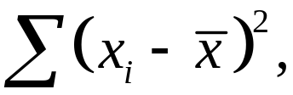

EXAMPLE Testing for a Linear Relation
(4 of 11)
Classical Approach
Step 3 We obtained an estimate of β₁ in a previous example to
be β₁ = 1.3991, and we computed the standard error,
s_{e} = 19.48, also in the previous example. To determine the standard deviation of β₁, compute where the x_{i} are
the values of the explanatory variable, age, and is the sample mean. We compute this value in Table 3, which is on the next slide.
14-36

Slide 37
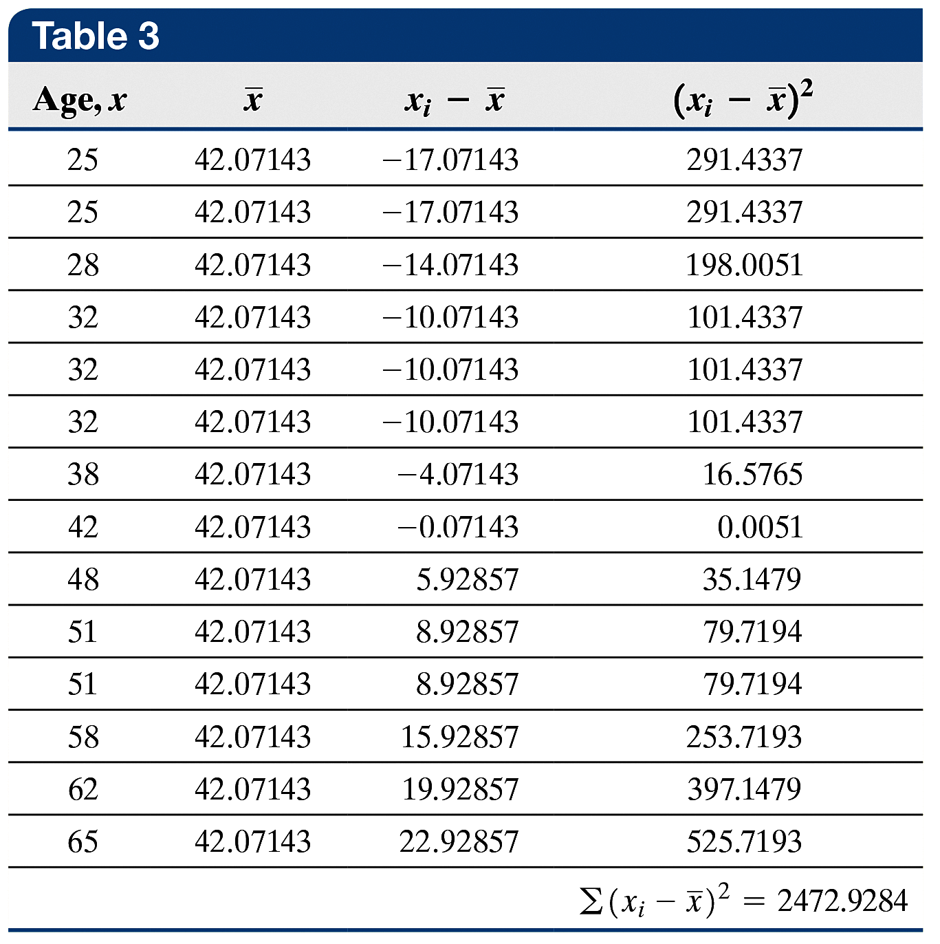
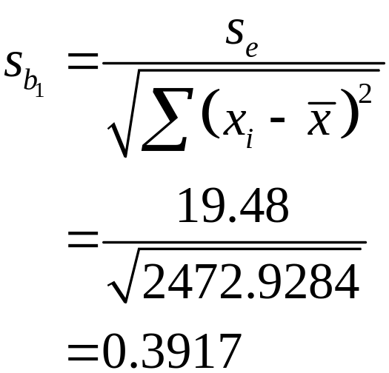
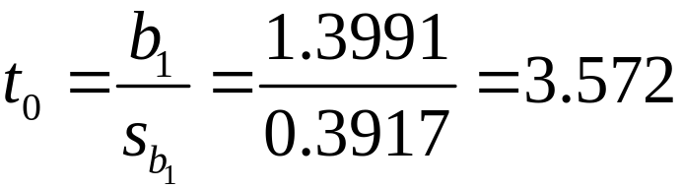
EXAMPLE Testing for a Linear Relation
(5 of 11)
Classical Approach
We have
The test statistic is
14-37

Slide 38
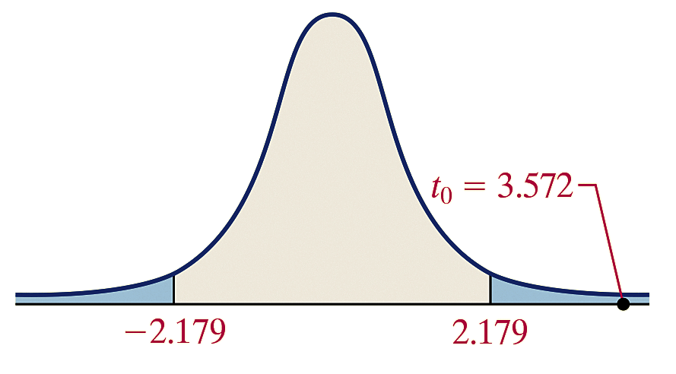
EXAMPLE Testing for a Linear Relation
(6 of 11)
Classical Approach
Because this is a two-tailed test, we determine the critical t-values at the α = 0.05 level of significance with n – 2 = 14 – 2 = 12 degrees of freedom to be –t_{0.05/2} = –t_{0.025} = –2.179 and t_{0.05/2} = t_{0.025} = 2.179. The critical regions are displayed in the figure.
The test statistic is t₀ = 3.572.
We label this point in the
figure.
14-38

Slide 39
EXAMPLE Testing for a Linear Relation
(7 of 11)
Classical Approach
Because the test statistic is greater than the critical value
t_{0.025} = 2.179, we reject the null hypothesis.
Step 5 There is sufficient evidence at the α = 0.05 level of significance to conclude that a linear relation exists between age and total cholesterol.
14-39

Slide 40
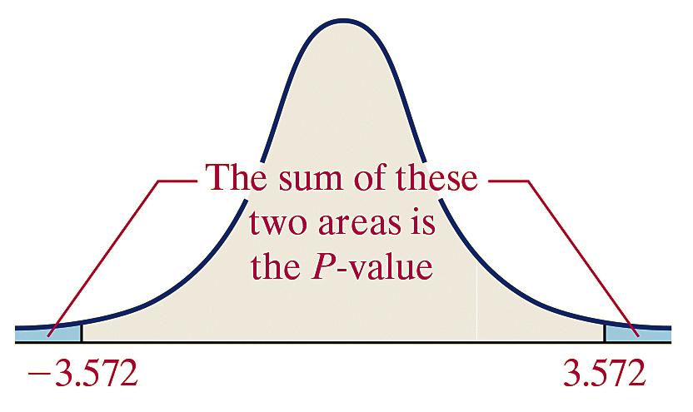
EXAMPLE Testing for a Linear Relation
(8 of 11)
P-Value Approach
From Step 3 of the Classical Approach, we have that the test statistic is t₀ = 3.572.
Because this is a two-tailed test, the P-value is the sum of the area under the t-distribution with 14 – 2 = 12 degrees of freedom to the left of –t₀ = –3.572, and to the right of
t₀ = 3.572, as shown in the figure.
That is, P-value = P(t < – 3.572)
+ P(t > 3.572) = 2P(t > 3.572),
with 12 degrees of freedom.
14-40

Slide 41
EXAMPLE Testing for a Linear Relation
(9 of 11)
P-Value Approach
Using Table VII, we find the row that corresponds to 12 degrees of freedom. The value 3.572 lies between 3.428 and 3.930. The area under the t-distribution with 12 degrees of freedom to the right of 3.428 is 0.0025. The area under the t-distribution with 12 degrees of freedom to the right of 3.930 is 0.001.
Because 3.572 is between 3.428 and 3.930, the P-value
is between 2(0.001) and 2(0.0025). So,
0.002 < P-value < 0.005
Using Technology Step 3 Using Minitab, we find the P-value is 0.004. See the figure on the next slide.
14-41

Slide 42
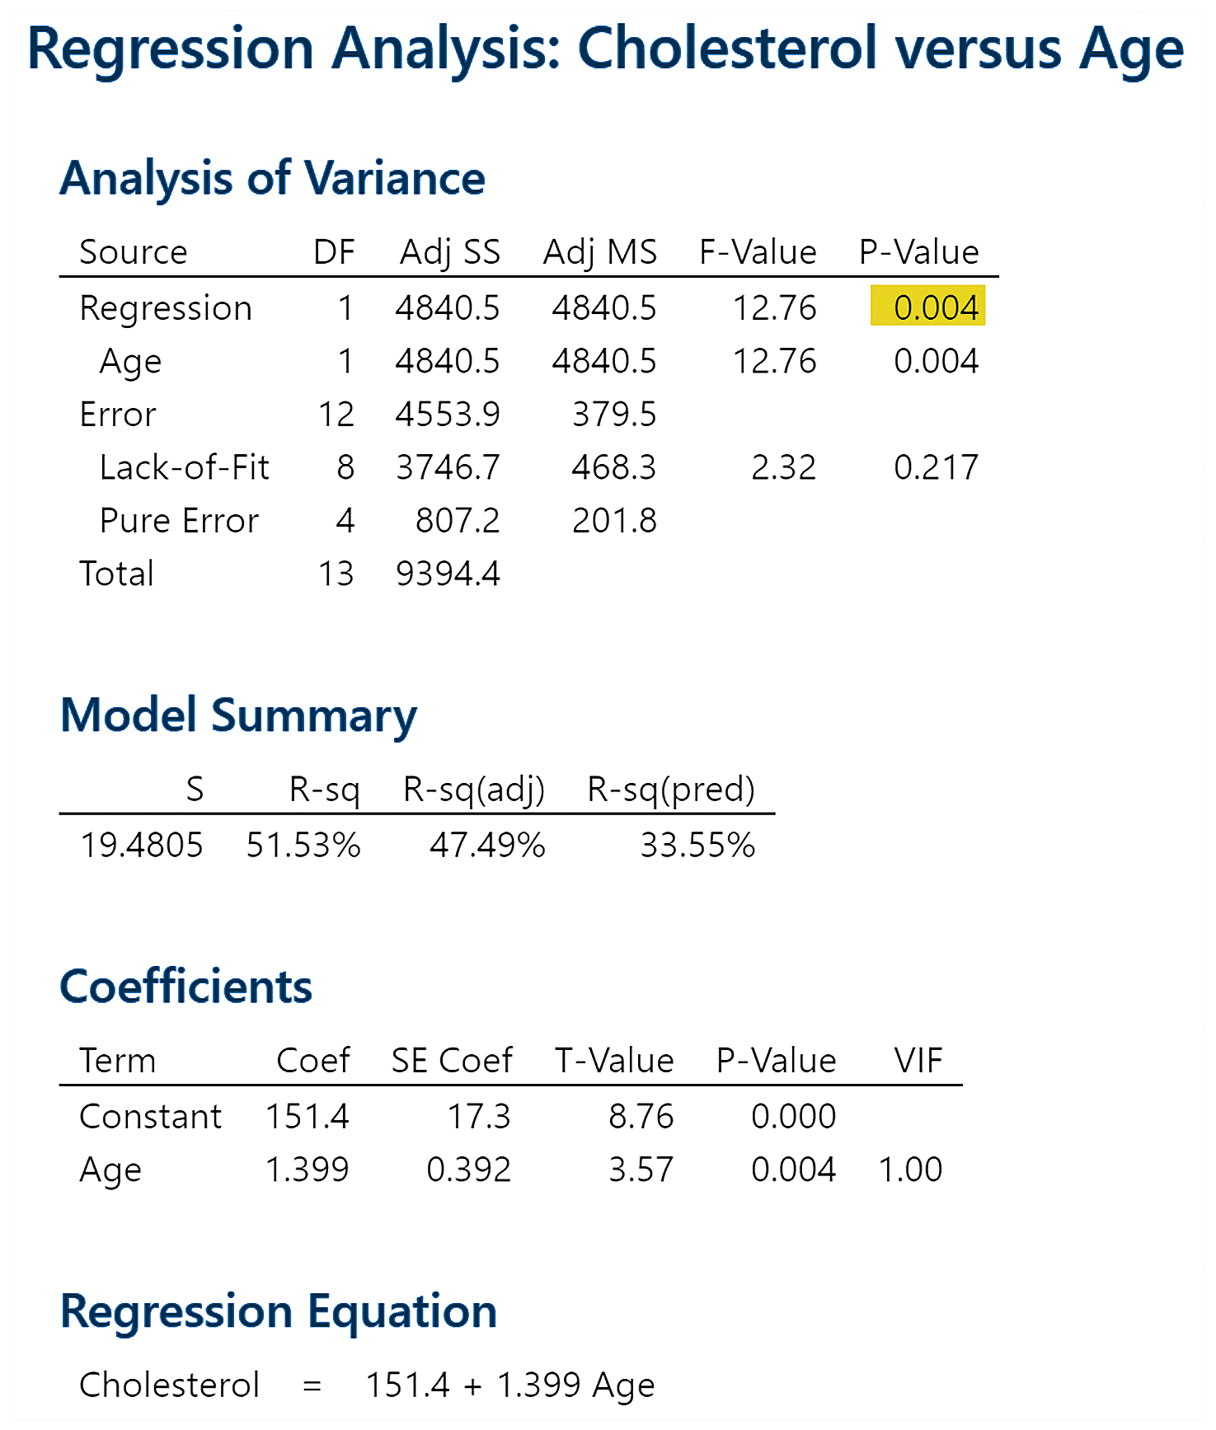
EXAMPLE Testing for a Linear Relation
(10 of 11)
P-Value Approach
14-42

Slide 43
EXAMPLE Testing for a Linear Relation
(11 of 11)
P-Value Approach
Step 4 The P-value of 0.004 suggests that about 4 samples in 1000 would yield a slope estimate that is as extreme as or more extreme than the one obtained if the null hypothesis of no linear relation were true. Because the P-value is less than the level of significance, α = 0.05, we reject the null hypothesis.
Step 5 There is sufficient evidence at the α = 0.05 level of significance to conclude that a linear relation exists between age and total cholesterol.
14-43

Slide 44
Objective 5
Construct a Confidence Interval about the Slope of the Least-Squares Regression Model
14-44

Slide 45

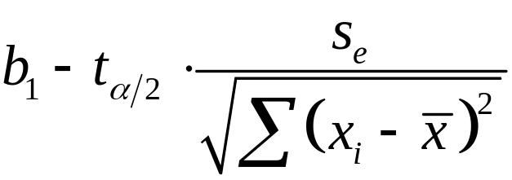
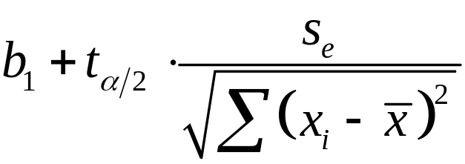
Confidence Intervals for the Slope of the Regression Line
A confidence interval for the slope of the true regression line, β₁, is given by the following formulas:
Lower bound:
Upper bound:
Here, t_{a/2} is computed using n – 2 degrees of freedom.
Note: This interval can be computed only if the data are randomly obtained, the residuals are normally distributed, and there is constant error variance.
(3)
14-45

Slide 46
EXAMPLE Constructing a Confidence Interval for the
(1 of 6) Slope of the True Regression Line
Determine a 95% confidence interval for the slope of the true regression line for the data presented in Table 1 in a previous example.
14-46

Slide 47

EXAMPLE Constructing a Confidence Interval for the
(2 of 6) Slope of the True Regression Line
By-Hand Solution
Step 1 The least-squares regression line was determined
in a previous example and is
Step 2 The requirements were verified in the previous examples.
Step 3 We computed s_{e} in a previous example, obtaining
s_{e} = 19.48.
Step 4 Because we wish to determine a 95% confidence interval, we have α = 0.05. Therefore, we need to find
t_{0.05/2} = t_{0.025} with 14 – 2 = 12 degrees of freedom.
Referring to Table VII, we find that t_{0.025} = 2.179.
14-47

Slide 48
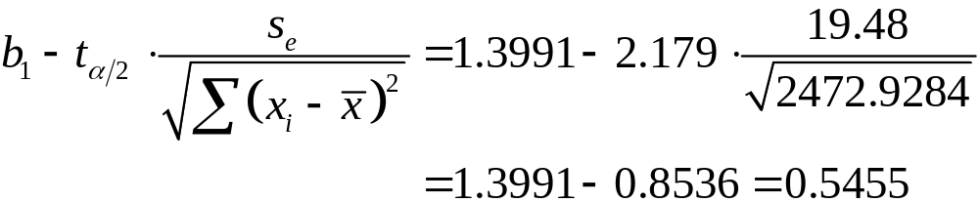
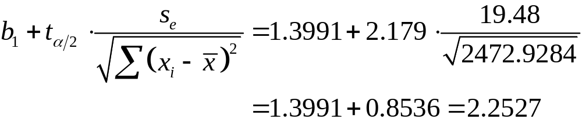
EXAMPLE Constructing a Confidence Interval for the
(3 of 6) Slope of the True Regression Line
By-Hand Solution
Step 5 We use Formula (3) to find the lower and upper bounds.
Lower bound:
Upper bound:
14-48

Slide 49
EXAMPLE Constructing a Confidence Interval for the
(4 of 6) Slope of the True Regression Line
By-Hand Solution
Step 6 We are 95% confident that the mean increase in
cholesterol for each additional year of life is somewhere
between 0.5455 mg/dL and 2.2527 mg/dL. Because the 95%
confidence interval does not include 0, we reject H₀: β₁ = 0.
14-49

Slide 50
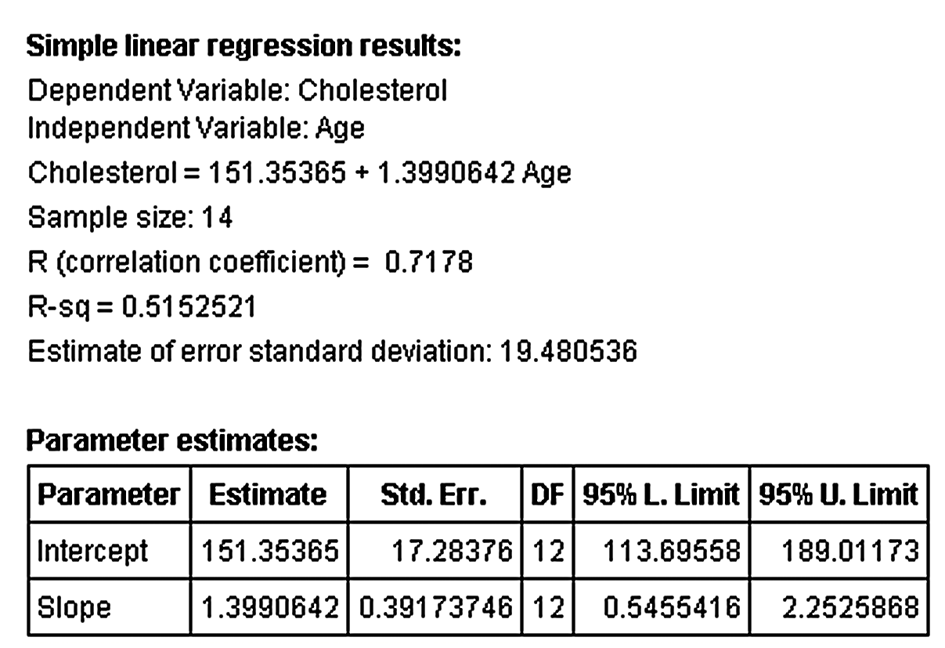
EXAMPLE Constructing a Confidence Interval for the
(5 of 6) Slope of the True Regression Line
Technology Solution
Step 1 The figure shows the results obtained from StatCrunch.
The lower bound (95% L. Limit) is 0.5455 and the upper bound (95% U. Limit) is 2.2526.
14-50

Slide 51
EXAMPLE Constructing a Confidence Interval for the
(6 of 6) Slope of the True Regression Line
Technology Solution
Step 2 We are 95% confident that the mean increase in cholesterol for each additional year of life is between 0.5455 mg/dL and 2.2526 mg/dL. Because the confidence interval does not contain 0, we reject H₀: β₁ = 0.
14-51

Slide 52
14.2 Confidence and Prediction
Intervals
Learning Objectives
Construct confidence intervals for a mean response
Construct prediction intervals for an individual response
14-52

Slide 53
Confidence intervals for a mean response are intervals constructed about the predicted value of y, at a given level of x, that are used to measure the accuracy of the mean response of all the individuals in the population where the value of the explanatory variable is x.
Prediction intervals for an individual response are intervals constructed about the predicted value of y that are used to measure the accuracy of a single individual’s predicted value.
14-53

Slide 54
Objective 1
Construct Confidence Intervals for a Mean Response
14-54

Slide 55


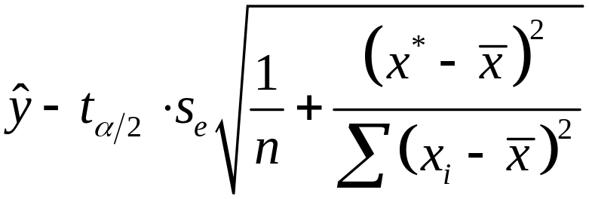

Confidence Interval for the Mean Response of y,
A confidence interval for the mean response of y for a specified value of x, is given by
Lower bound:
Upper bound:
(1)
where x* is the given value of the explanatory variable, n is the number of observations, and t_{α/2} is the critical value with n – 2 degrees of freedom.
14-55

Slide 56
EXAMPLE Constructing a Confidence Interval for a
(1 of 4) Mean Response by Hand
Construct a 95% confidence interval for the predicted mean total cholesterol of all 42-year-old females using the data in Table 1.
14-56

Slide 57

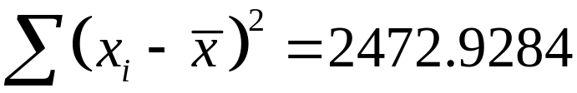


EXAMPLE Constructing a Confidence Interval for a
(2 of 4) Mean Response by Hand
The least-squares regression equation is
To find the predicted mean total cholesterol of all 42-year-olds, let x* = 42 in the regression equation and obtain
mg/dL.
From a previous example, we found that s_{e} = 19.48, and from
another example we found that and
The critical t-value, with n – 2 = 14 – 2 = 12 degrees of freedom is 2.179.
14-57

Slide 58
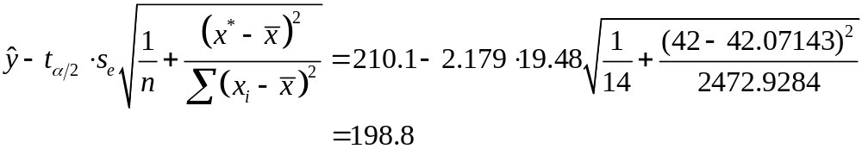

EXAMPLE Constructing a Confidence Interval for a
(3 of 4) Mean Response by Hand
The 95% confidence interval for the predicted mean total cholesterol for all 42-year-old females is therefore
Lower bound:
Upper bound:
14-58

Slide 59
EXAMPLE Constructing a Confidence Interval for a
(4 of 4) Mean Response by Hand
We are 95% confident that the mean total cholesterol of all 42-year-old females is between 198.8 mg/dL and 221.4 mg/dL.
14-59

Slide 60
Objective 2
Construct Prediction Intervals for an Individual Response.
14-60

Slide 61
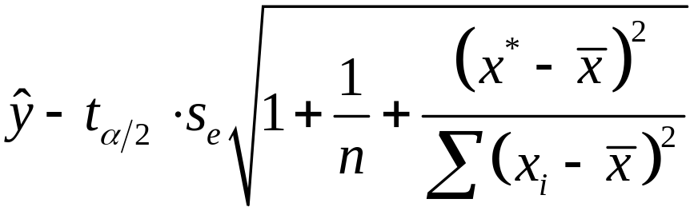
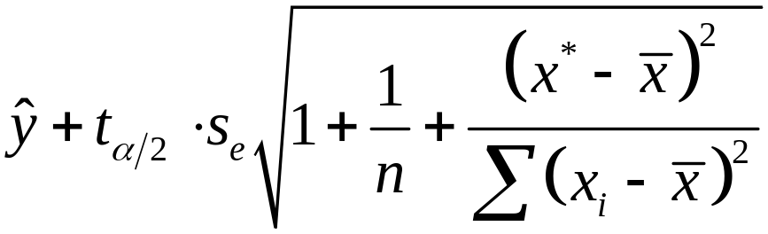
Confidence Interval for an Individual Response about
A prediction interval for the individual response of y, is given by
Lower bound:
Upper bound:
(2)
where x* is the given value of the explanatory variable, n is the number of observations, and t_{α/2} is the critical value with n – 2 degrees of freedom.
14-61

Slide 62
EXAMPLE Constructing a Prediction Interval for an
(1 of 4) Individual Response by Hand
Construct a 95% prediction interval for the predicted total cholesterol of a 42-year-old female.
14-62

Slide 63
EXAMPLE Constructing a Prediction Interval for an
(2 of 4) Individual Response by Hand
The least-squares regression equation is
To find the predicted total cholesterol of a 42-year-old, let
x* = 42 in the regression equation and obtain
mg/dL.
From a previous example, we found that s_{e} = 19.48, and from
another example we found that and
We find with n – 2 = 14 – 2 = 12 degrees of freedom to be 2.179.
14-63

Slide 64
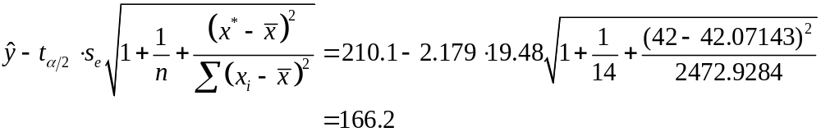
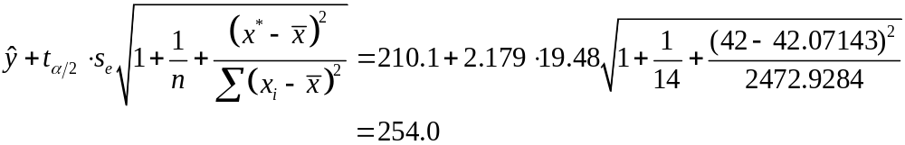
EXAMPLE Constructing a Prediction Interval for an
(3 of 4) Individual Response by Hand
The 95% prediction interval for the predicted total cholesterol for a 42-year-old female is
Lower bound:
Upper bound:
14-64

Slide 65
EXAMPLE Constructing a Prediction Interval for an
(4 of 4) Individual Response by Hand
We are 95% confident that the total cholesterol of a randomly selected 42-year-old female is between 166.2 mg/dL and
254.0 mg/dL.
14-65

Slide 66
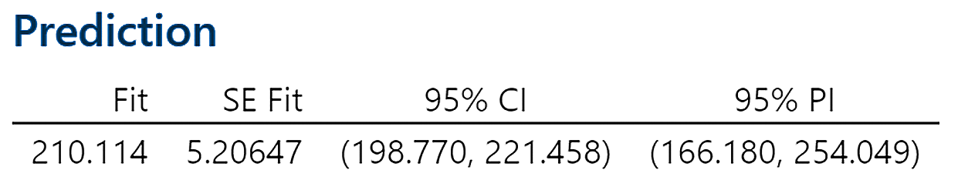
EXAMPLE Confidence and Prediction Intervals
Using Technology
Construct a 95% confidence interval for the predicted mean total cholesterol of all 42-year-old females using statistical software.
The figure shows the results obtained from Minitab.
14-66

Slide 67
14.3 Introduction to Multiple
Regression
Learning Objectives
Obtain the correlation matrix
Use technology to find a multiple regression equation
Interpret the coefficients of a multiple regression equation
Determine R² and adjusted R²
14-67

Slide 68
14.3 Introduction to Multiple
Regression
Learning Objectives Continued
Perform an F-test for lack of fit
Test individual regression coefficients for significance
Construct confidence and prediction intervals
14-68

Slide 69
Objective 1
Obtain the Correlation Matrix
14-69

Slide 70

A multiple regression model is given by
where
  y_{i} is the value of the response variable for the i^{th} individual
  x_{1i} is the value of the first explanatory variable for the ith observation, x_{2i} is value of the second explanatory variable for the ith observation, and so on
  β₀, β₁,…, β_{k} are the parameters to be estimated based on sample data
  ε_{i} is a random error term that is normally distributed with mean 0 and standard deviation
  The error terms are independent, and i = 1, 2,…, n, where n is the sample size.
(1)
14-70

Slide 71
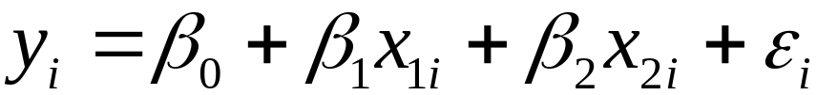
If there are two explanatory variables, model (1) reduces to
If there are three explanatory variables, model (1) reduces to
(2)
(3)
14-71

Slide 72
A correlation matrix shows the linear correlation between each pair of variables under consideration in a multiple regression model.
14-72

Slide 73
Multicollinearity exists between two explanatory variables if they have a high linear correlation.
14-73

Slide 74
CAUTION!
If two explanatory variables in the regression model are highly correlated with each other, watch out for strange results in the regression output.
14-74

Slide 75
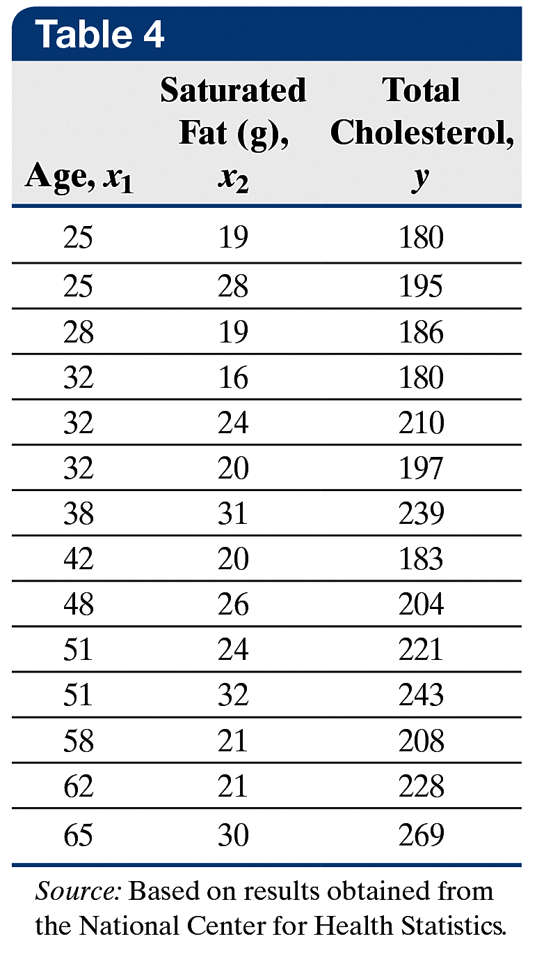
EXAMPLE Constructing a Correlation Matrix
(1 of 2)
A family doctor wishes to further examine the variables that affect his female patients’ total cholesterol. He randomly selects 14 of his female patients and asks them to determine their average daily consumption of saturated fat. He then measures their total cholesterol and obtains the data
in Table 4.
14-75

Slide 76
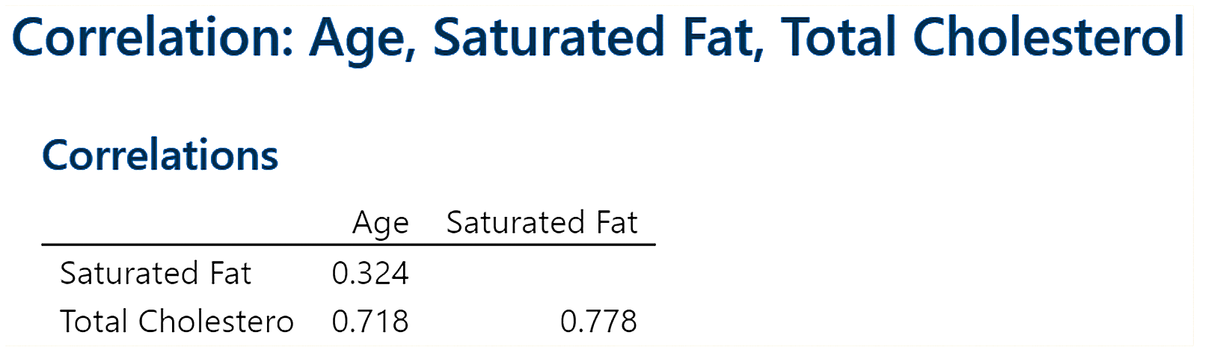
EXAMPLE Constructing a Correlation Matrix
(2 of 2)
The figure shows the correlation matrix from Minitab.
The linear correlation between total cholesterol and age is 0.718. The linear correlation between total cholesterol and average daily consumption of saturated fat is 0.778. Because the linear correlation between average daily consumption and age, the two explanatory variables, is only 0.324, we are not concerned with multicollinearity.
14-76

Slide 77
Objective 2
Use Technology to Find a Multiple Regression Equation
14-77

Slide 78

EXAMPLE Multiple Regression
(1 of 6)
Use the data in Table 4 presented in the previous example.
(a) Find the least-squares regression
equation where
x₁ represents the patient’s age, x₂
represents the patient’s daily
consumption of saturated fat, and y
represents the patient’s total
cholesterol.
14-78

Slide 79

EXAMPLE Multiple Regression
(2 of 6)
(a) The figure on the next slide shows the output from Minitab.
The least-squares regression equation for these data is
14-79

Slide 80
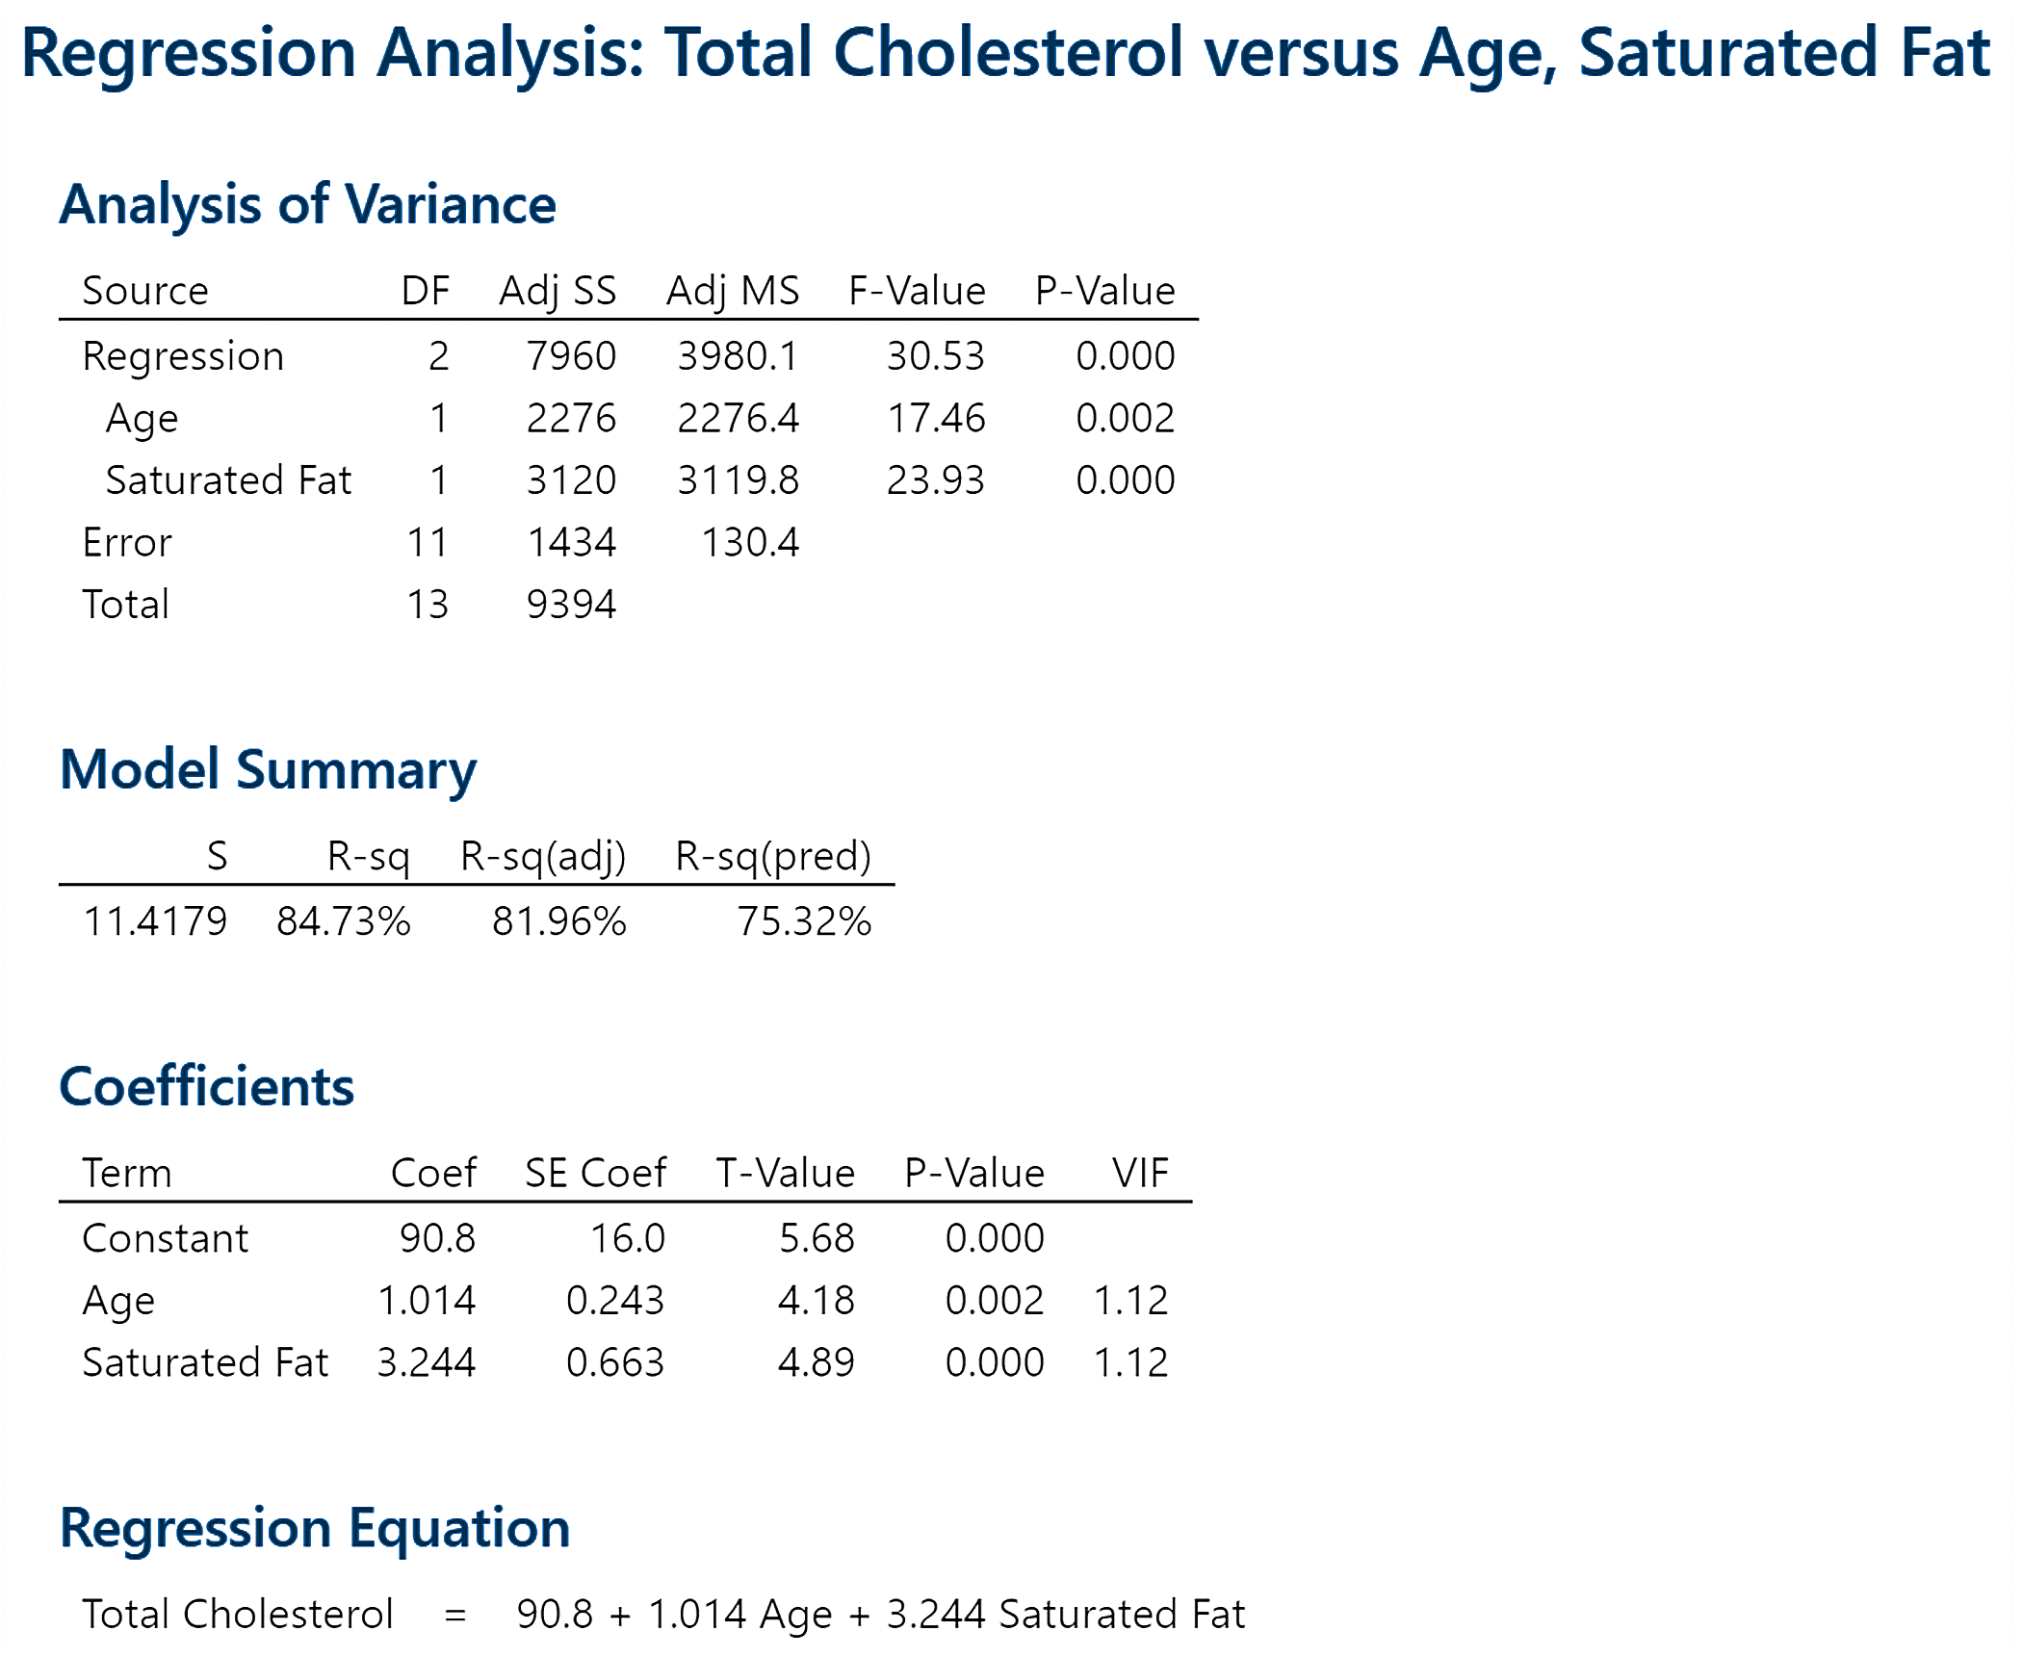
EXAMPLE Multiple Regression
(3 of 6)
(a)
14-80

Slide 81

EXAMPLE Multiple Regression
(4 of 6)
(b) Draw residual plots and a boxplot of the residuals to
assess the adequacy of the model.
Figure (a) on the next slide shows a plot of residuals
against the predicted values, To obtain this plot by hand,
first find all the fitted values. For example, the predicted (or
fitted) value for the first observation in Table 4 (age = 25,
fat consumption = 19) is
= 177.8 mg/dL. Therefore, residual = observed – predicted
= 180 – 177.8 = 2.2 mg/dL. Now plot the point (177.8, 2.2)
on the graph. Repeat this for the remaining observations.
14-81

Slide 82
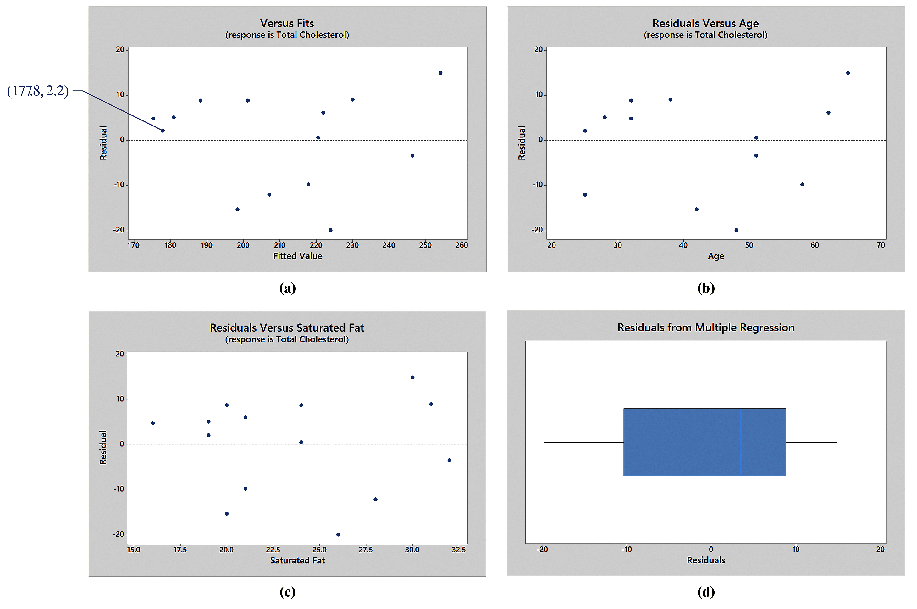
EXAMPLE Multiple Regression
(5 of 6)
(b)
14-82

Slide 83
EXAMPLE Multiple Regression
(6 of 6)
(b) Figure (b) shows a plot of residuals against the explanatory
variable, age. Figure (c) shows a plot of residuals against
the explanatory variable saturated fat. Figure (d) shows a
boxplot of the residuals.
None of the residual plots show any discernible pattern, and
the boxplot does not show any outliers. Therefore, the
linear model is appropriate.
14-83

Slide 84
Objective 3
Interpret the Coefficients of a Multiple Regression Equation
14-84

Slide 85
EXAMPLE Interpreting Regression Coefficients
(1 of 2)
Interpret the regression coefficients for the least-squares regression equation found in the previous example.
14-85

Slide 86

EXAMPLE Interpreting Regression Coefficients
(2 of 2)
The least-squares regression equation found in the previous example was where x₁ represents the patient’s age and x₂ represents the patient’s average daily consumption of saturated fat (in grams).
The regression coefficient, b₁ = 1.014, means that, if the patient’s age increases by one year then total cholesterol increases by 1.014 mg/dL, on average, assuming that the average daily consumption of saturated fat remains unchanged.
The regression coefficient, b₂ = 3.244, means that, if the patient’s average daily consumption of saturated fat increases by 1 gram, total cholesterol increases by 3.244 mg/dL, on average, assuming that age remains unchanged.
14-86

Slide 87
Objective 4
Determine R² and Adjusted R²
14-87

Slide 88
The value of R² always increases by adding one more explanatory variable.
14-88

Slide 89
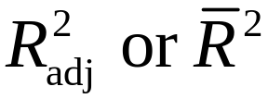
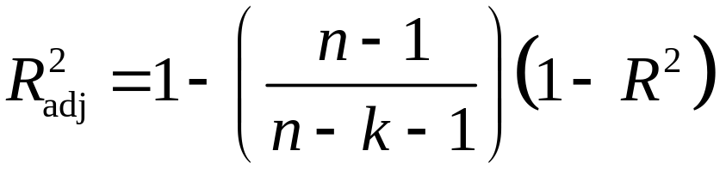
The adjusted R², denoted , is the adjusted coefficient of determination. It modifies the value of R² based on the sample size, n, and the number of explanatory variables, k. The formula for the adjusted R² is
14-89

Slide 90
The adjusted R² “punishes” the model for adding an explanatory variable that does little to explain variation in the response variable.
14-90

Slide 91
CAUTION!
Never use R² to compare regression models with a different number of explanatory variables. Rather, use the adjusted R².
14-91

Slide 92

EXAMPLE Coefficient of Determination
(1 of 3)
For the model obtained in a previous example,
determine the coefficient of determination R² and the adjusted R². Compare the R² with the two explanatory variables age and daily saturated fat to the R² with the single explanatory variable age. Comment
on the effect the additional explanatory variable has on the value of the model.
14-92

Slide 93
EXAMPLE Coefficient of Determination
(2 of 3)
Looking back to
the output from
a previous
example, we see
that R² = 0.847
= 84.7%.
14-93

Slide 94
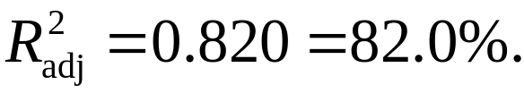
EXAMPLE Coefficient of Determination
(3 of 3)
This means that 84.7% of the variation in the response variable is explained by the least-squares regression model. In addition, we find that
If we look back to another previous
figure, we see that R² = 51.5% with
age as the only explanatory variable.
Based on the adjusted R² with the two explanatory variables age and daily saturated fat consumption, we conclude that the additional variable increases the proportion of explained variation.
14-94

Slide 95
Objective 5
Perform an F-Test for Lack of Fit
14-95

Slide 96
The null hypothesis states that there is no linear relation between the explanatory variables and the response variable. The alternative hypothesis states that there is a linear relation between at least one explanatory variable and the response variable.
14-96

Slide 97
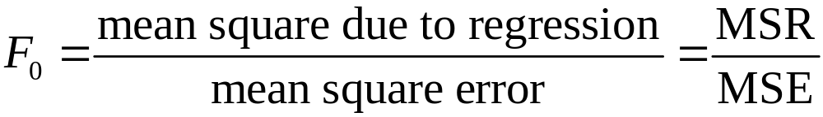
Test Statistic for Multiple Regression
with k – 1 degrees of freedom in the numerator and n – k degrees of freedom in the denominator, where k is the number of explanatory variables and n is the sample size.
14-97

Slide 98
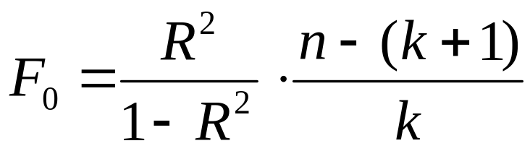
F-Test Statistic for Multiple Regression Using R²
where
R² is the coefficient of determination
k is the number of explanatory variables
n is the sample size
14-98

Slide 99
Decision Rule for Testing
H₀: β₁ = β₂ = ··· = β_{k} = 0
If the P-value is less than the level of significance, α, reject the null hypothesis. Otherwise, do not reject the null hypothesis.
14-99

Slide 100


EXAMPLE Inference on the Regression Model
(1 of 5)
Test versus H₁: at least one for the regression model, found in a previous example.
14-100

Slide 101
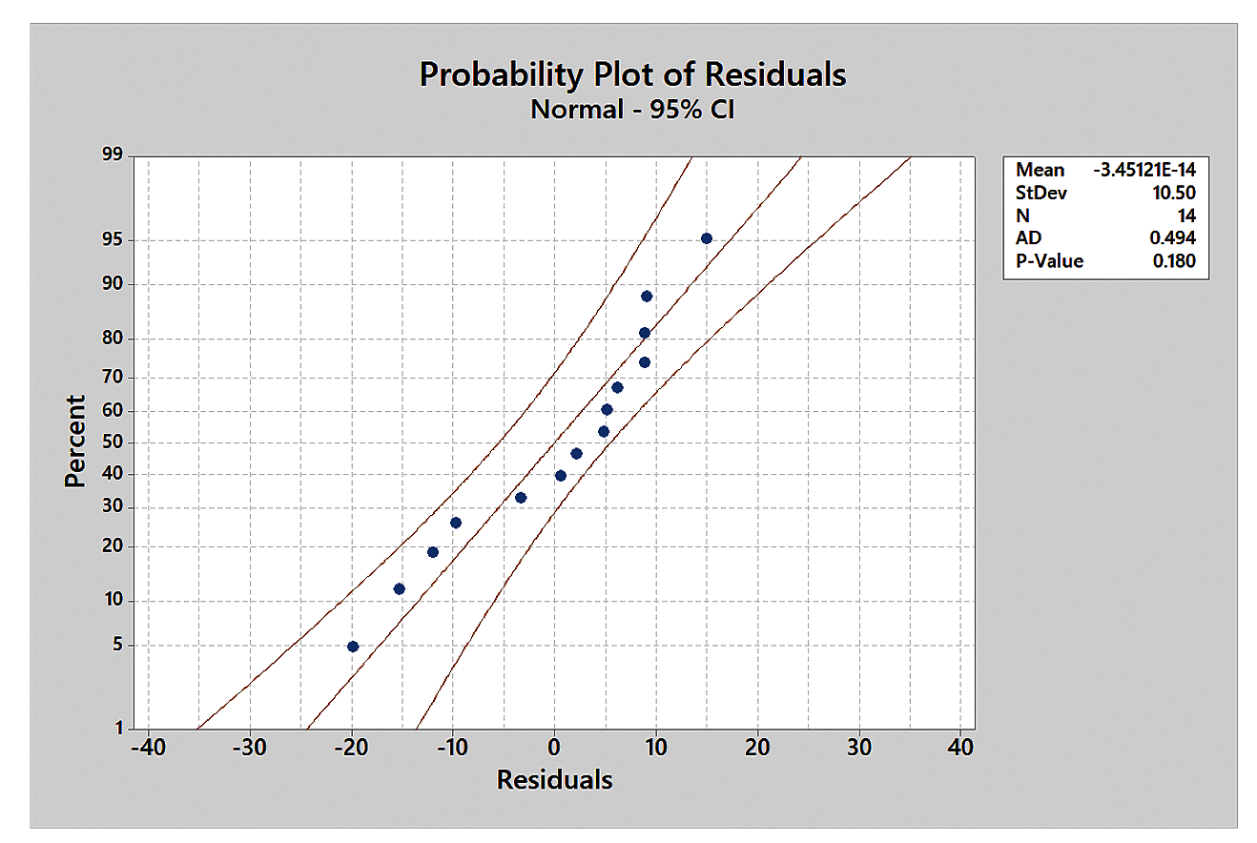
EXAMPLE Inference on the Regression Model
(2 of 5)
The figure shows the normal probability plot of the residuals drawn in Minitab.
14-101

Slide 102
EXAMPLE Inference on the Regression Model
(3 of 5)
Because the points are roughly linear (or lie within the confidence bounds drawn by Minitab), it is reasonable to conclude that the residuals are normally distributed.
Alternatively, the correlation between the residuals and expected z-scores is 0.967. Because 0.967 > 0.935 (Table VI), the residuals appear to be normally distributed.
In addition, the boxplot of the
residuals drawn previously,
shown in Figure (d), indicates
that there are no outliers.
Therefore, we can continue with
the inference.
14-102

Slide 103
EXAMPLE Inference on the Regression Model
(4 of 5)
If we look back
at the output in
a previous figure,
we see that the
F-test statistic
is 30.53 with a
P-value reported
as 0.000.
14-103

Slide 104
EXAMPLE Inference on the Regression Model
(5 of 5)
This small P-value is sufficient evidence against the null hypothesis. So we reject the null hypothesis and conclude that at least one of the regression coefficients is different from zero. There is a linear relation between at least one of the explanatory variables and the response variable.
14-104

Slide 105
CAUTION!
If we reject the null hypothesis that all the slope coefficients are zero, then we are saying that at least one of the slopes is different from zero, not that they all are different from zero.
14-105

Slide 106
Objective 6
Test Individual Regression Coefficients for Significance
14-106

Slide 107


EXAMPLE Test the Significance of Individual
(1 of 3) Predictor Variables
For the model presented in the previous examples, test the hypotheses
where β₁ is the slope coefficient for the explanatory variable age, and β₂ is the slope coefficient for the explanatory variable saturated fat.
14-107

Slide 108
EXAMPLE Test the Significance of Individual
(2 of 3) Predictor Variables
Looking again
at the figure
shown, we see
the test statistic
for the
explanatory
variable age is
t₀ = 4.18 with a
P-value = 0.002.
14-108

Slide 109
EXAMPLE Test the Significance of Individual
(3 of 3) Predictor Variables
We also see that the test statistic for the explanatory variable saturated fat is t₀ = 4.89 with a P-value = 0.000.
Since both P-values are sufficiently small, we reject each null hypothesis. Conclude that both explanatory variables have a significant linear relation with the response variable, total cholesterol.
14-109

Slide 110
Objective 7
Construct Confidence and Prediction Intervals
14-110

Slide 111
EXAMPLE Confidence and Prediction Intervals
(1 of 3)
Construct a 95% confidence interval for a mean response and a 95% prediction interval for an individual response for a 32-year-old female who consumes 23 grams of saturated fat daily using the model determined in a previous example. Be sure to interpret the results.
14-111

Slide 112

EXAMPLE Confidence and Prediction Intervals
(2 of 3)
The figure shows the partial output from Minitab.
14-112

Slide 113
EXAMPLE Confidence and Prediction Intervals
(3 of 3)
Based on the Minitab output, we are 95% confident that the mean total cholesterol of all 32-year-old females who consume 23 grams of saturated fat daily is between 189.4 mg/dL and 206.4 mg/dL. We are 95% confident that the total cholesterol of a particular 32-year-old female who consumes 23 grams of saturated fat daily is between 171.4 mg/dL and 224.4 mg/dL.
14-113

Slide 114
Multicollinearity Revisited
Suppose that two explanatory variables that have a strong linear association with the response variable are highly correlated with each other. One consequence of this correlation can be that their t-test statistics are small and their P-values are large. The reason for this is that the t-test statistics are marginal.
The word marginal means incremental.
14-114

Slide 115

EXAMPLE Effects of Multicollinearity
(1 of 5)
Using the data presented in Table 5:
(a) Find the correlation matrix
among all three variables.
14-115

Slide 116

EXAMPLE Effects of Multicollinearity
(2 of 5)
(a) The figure shows the correlation matrix.
An extremely high correlation exists between x₁ and x₂, so
multicollinearity exists between the two variables.
14-116

Slide 117
EXAMPLE Effects of Multicollinearity
(3 of 5)
(b) Find the least-squares regression model using both x₁
and x₂ as explanatory variables.
The figure on the next slide shows the regression output
from StatCrunch. First, notice that the P-value for the F-
test statistic is 0.0179, indicating that at least one of the
slope coefficients is different from zero. However, if we
look at each individual t-test statistic, we see that each has
a very high P-value (P-value for x₁: 0.9987; P-value for x₂:
0.7074), indicating that neither coefficient is different from
zero.
14-117

Slide 118

EXAMPLE Effects of Multicollinearity
(4 of 5)
(b)
14-118

Slide 119
EXAMPLE Effects of Multicollinearity
(5 of 5)
(c) Comment on the effect that including both x₁ and x₂
has on the t-test statistics.
The contradictory results of the regression output occur
because both x₁ and x₂ are related to the response variable
y, as indicated by the correlation matrix. However, x₁ and
x₂ are also related to each other. So, with x₁ in the model, x₂
adds little explanation. Likewise, with x₂ in the model, x₁
adds little explanation. The solution is to use only one
explanatory variable. Which explanatory variable we
choose is up to us. We can choose either the explanatory
variable with the lower P-value or the explanatory variable
that has the higher correlation with the response.
14-119

Slide 120
14.4 Interaction and Dummy
Variables
Learning Objectives
Work with multiple regression models with interaction
Build multiple regression models with indicator variables
14-120

Slide 121
Objective 1
Work with Multiple Regression Models with Interaction
14-121

Slide 122
If the mean value of the response variable y in a least-squares regression associated with a 1-unit change in an explanatory variable depends on a second explanatory variable, there is interaction between the two explanatory variables. When interaction exists between two explanatory variables, x₁ and x₂, we introduce a term with the
variable x₁x₂ in the regression model as an explanatory variable.
14-122

Slide 123
The complete second-order model with two explanatory variables x₁ and x₂ is
14-123

Slide 124
EXAMPLE A Multiple Regression Model with
(1 of 11) Interaction
The wind chill index represents what the air feels like on exposed skin while factoring in wind speed. The wind chill index is determined by considering the wind speed at a height of 5 feet, the typical height of an adult human face. A model for determining wind chill based on the air temperature and wind speed developed by the National Weather Service is
W = 35.74 + 0.6215T – 35.75V + 0.4275TV
where W is the wind chill (in °F)
T is the air temperature (in °F)
V is the velocity of the wind (in miles per hour) raised to
the 0.16 power (so V = v^{0.16})
The variable velocity is transformed by raising the actual wind speed to the 0.16 power to account for the nonlinear relation between wind chill and wind speed.
14-124

Slide 125
EXAMPLE A Multiple Regression Model with
(2 of 11) Interaction
(a) The data in Table 6, on the following slide, show the
wind chill temperature for various wind speeds and
temperatures. Use the data to draw a scatter diagram of
wind chill temperature versus air temperature, treating
wind chill temperature as the response variable and
using a different plotting symbol for each wind speed.
Then draw a scatter diagram of wind chill temperature
versus wind speed, treating wind chill temperature as
the response variable and using a different plotting
symbol for each air temperature.
14-125

Slide 126

EXAMPLE A Multiple Regression Model with
(3 of 11) Interaction
(a)
14-126

Slide 127

EXAMPLE A Multiple Regression Model with
(4 of 11) Interaction
(a) The figure shows the scatter diagram drawn in Minitab of
wind chill temperature versus air temperature using a
different plotting symbol for each wind speed.
14-127

Slide 128
EXAMPLE A Multiple Regression Model with
(5 of 11) Interaction
(a) Notice that the points for each wind speed are not parallel.
The differences in wind chill temperature at very low air
temperature are more significant for different wind speeds
than the differences in wind chill temperature at higher
temperatures for different wind speeds. This implies an
interaction effect between air temperature and wind speed.
The figure on the next slide shows the scatter diagram of
wind chill temperature versus wind velocity using a
different plotting symbol for each air temperature. Not only
are the points for each air temperature not parallel, but the
data do not follow a linear pattern.
14-128

Slide 129

EXAMPLE A Multiple Regression Model with
(6 of 11) Interaction
For example, at an air temperature of –45°F (the ● symbol),
it is clear that the data do not follow a linear pattern.
14-129

Slide 130
EXAMPLE A Multiple Regression Model with
(7 of 11) Interaction
This is the reason that we needed to transform the variable
wind speed by raising the variable to the 0.16 power.
Popular transformations include the square root
transformation and the logarithmic transformation in order
to linearize data.
14-130

Slide 131
EXAMPLE A Multiple Regression Model with
(8 of 11) Interaction
(b) Use the model to predict the wind chill temperature if
the air temperature is 3°F and the wind speed is 13
miles per hour (mph).
Let T = 3°F and V = 13^{0.16} (v = 13 mph) in the model to
predict the wind chill temperature at 3°F with a wind speed
of 13 mph.
W = 35.74 + 0.6215T – 35.75V + 0.4275TV
= 35.74 + 0.6215(3) – 35.75(13^{0.16}) + 0.4275(3)(13^{0.16})
= –14
Rounded to the nearest degree, the wind chill temperature
at an air temperature of 3°F with a wind speed of 13 mph is
–14°F.
14-131

Slide 132
EXAMPLE A Multiple Regression Model with
(9 of 11) Interaction
(c) Interpret the model for a wind speed of 20 mph.
Interpret the model for a wind speed of 30 mph.
At a wind velocity of 20 mph, the expected wind chill is
W = 35.74 + 0.6215T – 35.75V + 0.4275TV
= 35.74 + 0.6215T – 35.75(20^{0.16}) + 0.4275T(20^{0.16})
= 35.74 + 0.6215T – 57.7352 + 0.6904T
= – 21.9952 + 1.3119T
At a wind velocity of 20 mph, as the temperature increases
by 1°F, the wind chill temperature increases about
1.3119°F, on average.
14-132

Slide 133
EXAMPLE A Multiple Regression Model with
(10 of 11) Interaction
(c) At a wind velocity of 30 mph, the expected wind chill is
W = 35.74 + 0.6215T – 35.75V + 0.4275TV
= 35.74 + 0.6215T – 35.75(30^{0.16}) + 0.4275T(30^{0.16})
= 35.74 + 0.6215T – 61.6049 + 0.7367T
= – 25.8649 + 1.3582T
At a wind velocity of 30 mph, as the temperature increases
by 1°F, the wind chill temperature increases about
1.3582°F, on average.
14-133

Slide 134
EXAMPLE A Multiple Regression Model with
(11 of 11) Interaction
(c) We can see that a higher wind speed results in a higher
impact on the wind chill temperature. Think about it this
way: if the air temperature decreases from 20°F to 19°F,
we would expect the wind chill temperature to decrease by
1.3119°F when the wind speed is 20 miles per hour, while
we would expect the wind chill temperature to decrease by
1.3582°F when the wind speed is 30 miles per hour.
14-134

Slide 135
Objective 2
Build Multiple Regression Models with Indicator Variables
14-135

Slide 136
An indicator (or dummy) variable is a qualitative explanatory variable in a multiple regression model that takes on the value 0 or 1.
14-136

Slide 137

EXAMPLE A Multiple Regression Model with
(1 of 6) an Indicator Variable
The data in Table 7 represent the number of licensed drivers in various age groups and the number of fatal accidents within the age group by gender.
14-137

Slide 138


EXAMPLE A Multiple Regression Model with
(2 of 6) an Indicator Variable
(a) Draw a scatter diagram of the data treating number of
licensed drivers as the explanatory variable and
number of fatal crashes as the response variable using
a different plotting symbol for each gender.
The figure on the next slide shows the scatter diagram of
the data drawn in Minitab. For males (0) we use the symbol
and for females (1) we use the symbol
14-138

Slide 139

EXAMPLE A Multiple Regression Model with
(3 of 6) an Indicator Variable
(a)
For each gender, there is a positive association between the
variables. In addition, the slope for the males appears to be
much steeper than that of the females.
14-139

Slide 140

EXAMPLE A Multiple Regression Model with
(4 of 6) an Indicator Variable
(b) Find the least-squares equation
where x₁ is the number of licensed drivers, x₂ is an
indicator variable where 0 = male, 1 = female, and y is
the number of fatal crashes.
Using Minitab, we find that the least-squares regression
equation is
14-140

Slide 141
EXAMPLE A Multiple Regression Model with
(5 of 6) an Indicator Variable
(c) Interpret the coefficient of each explanatory variable.
Because the model is additive, we interpret the coefficients
the same way as we did for a regression with one
explanatory variable. However, we assume the other
variable is held constant.
So, for the variable x₁ = number of licensed drivers,
which is measured in thousands, the coefficient is 0.2254.
Therefore, if the number of licensed drivers increases by 1
thousand, we expect the number of fatal crashes to increase
by 0.2254.
14-141

Slide 142
EXAMPLE A Multiple Regression Model with
(6 of 6) an Indicator Variable
(c) For the variable x₂ = gender, the coefficient is –3103.
Therefore, we expect 3103 fewer fatal crashes for females
than males at any level of number of drivers. This explains
why females have lower insurance premiums than males!
14-142

Slide 143
In general, if there are c categories for a qualitative explanatory variable, the
regression model will require c – 1 indicator variables, each taking on a value of 0 or 1.
14-143

Slide 144
14.5 Polynomial Regression
Learning Objectives
Find a Quadratic Regression Equation
14-144

Slide 145

A regression model can include quadratic terms.
Scatter diagrams of the response variable drawn against each explanatory variable are used to determine the type of relation that may exist between the two variables.
We consider quadratic models of the form
Once a quadratic model is obtained, we go through the usual analysis of (1) drawing residual plots to verify the model is appropriate, (2) performing an F-test for lack of fit, and (3) testing individual regression coefficients for significance.
14-145

Slide 146

EXAMPLE Building a Quadratic Model
(1 of 11)
Photosynthetic efficiency is the percentage of light energy that is converted into chemical energy by a plant. The chemical energy is used by a plant to maintain the plant’s activities. A sample of grass was used to determine the efficiency of the grass species. Table 8 shows the results of the study at various temperatures, measured in degrees Celsius. The efficiency is measured as a percent.
14-146

Slide 147

EXAMPLE Building a Quadratic Model
(2 of 11)
(a) Draw a scatter diagram of the data. What type of
relation appears to exist between temperature and
efficiency?
The figure shows a
scatter diagram of the
data.
Clearly, there is a
quadratic relation
between temperature
and efficiency.
14-147

Slide 148

EXAMPLE Building a Quadratic Model
(3 of 11)
(b) Find the quadratic regression equation
The figure on the next slide shows the output from
StatCrunch. In anticipation of answering parts (c) and (f),
save the residuals and fitted values in the spreadsheet, and
ask StatCrunch to make a prediction for x = 18 degrees
Celsius.
14-148

Slide 149

EXAMPLE Building a Quadratic Model
(4 of 11)
(b)
14-149

Slide 150
EXAMPLE Building a Quadratic Model
(5 of 11)
(b) The coefficients for the quadratic regression equation are in
the first table under the heading “Estimate.”
The quadratic regression equation for these data is
14-150

Slide 151
EXAMPLE Building a Quadratic Model
(6 of 11)
(c) Draw a residual plot against the fitted values, x, and x².
Also, draw a boxplot of the residuals. Are there any
problems with the model?
Figures (a)–(c) on the next slide show residual plots of the
fitted values, x, and x². Figure (d) shows a boxplot of the
residuals.
14-151

Slide 152

EXAMPLE Building a Quadratic Model
(7 of 11)
(c)
None of the
residual plots show
any obvious pattern,
and the boxplot
does not show any
outliers.
Therefore, the
quadratic model
is appropriate.
14-152

Slide 153
EXAMPLE Building a Quadratic Model
(8 of 11)
(d) Interpret the coefficient of determination.
From the output in the StatCrunch figure, the coefficient of
determination, R², is 0.974 = 97.4%.
Therefore, 97.4% of the variation in efficiency is explained
by the quadratic model.
14-153

Slide 154


EXAMPLE Building a Quadratic Model
(9 of 11)
(e) Does the F-test indicate that we should reject
Is either coefficient not significantly
different from zero?
To test versus H₁: at least one of the
regression coefficients is different from 0, we look at the
F-test statistic from the analysis of variance output and see
that F = 185.67 with a P-value reported as < 0.0001. This
small P-value is sufficient evidence against the statement in
the null hypothesis.
Therefore, we reject the null hypothesis and conclude that
at least one of the regression coefficients is different from
zero.
14-154

Slide 155


EXAMPLE Building a Quadratic Model
(10 of 11)
(e)
and
Looking again at the output in the StatCrunch figure, we
see that the test statistic for temperature, x, is t₀ = 19.09
with a P-value < 0.0001. We also see that the test statistic
for temperature², x², is t₀ = –19.01 with a P-value < 0.0001.
Since both P-values are sufficiently small, we reject each
null hypothesis. We conclude that both temperature and
temperature² are significantly different from zero.
14-155

Slide 156

EXAMPLE Building a Quadratic Model
(11 of 11)
(f) Construct and interpret 95% confidence and prediction
intervals for x = 18 degrees Celsius.
The figure shows partial output from StatCrunch.
Based on the output, we are 95% confident that the mean
efficiency at a temperature of 18 degrees Celsius is between
84.4% and 90.9%. We are 95% confident that the efficiency
for a particular grass plant at a temperature of 18 degrees
Celsius is between 78.7% and 96.7%.
14-156

Slide 157
14.6 Building a Regression
Model
Learning Objectives
Perform a partial F-test
Build a regression model
14-157

Slide 158
Objective 1
Perform a Partial F-Test
14-158

Slide 159
We now introduce a third test, called the partial F-test, which is used to determine if at least one of a subset of regression coefficients in a multiple regression model is different from zero.
14-159

Slide 160


To test
versus
H₁: at least on of the coefficients, is different
from zero
find the least-squares regression of both Model 1 and Model 2.
If Model 2 contributes significantly to explaining the value of y, then we would expect the sum of squared errors (SSE) in Model 2 to be significantly less than the SSE in Model 1. So, the greater the difference in sum of squared errors between the two models, the stronger the evidence against H₀.
14-160

Slide 161

The test statistic for this hypothesis test is
where
SSE(1) is the sum of squared errors from Model 1 (the
reduced model)
SSE(2) is the sum of squared errors from Model 2 (the
full model)
k is the number of explanatory variables in Model 2
r is the number of explanatory variables in Model 1
14-161

Slide 162
EXAMPLE A Partial F-Test
(1 of 5)
The data in Table 9, shown on the next slide, represent the miles per gallon (MPG) along with potential explanatory variables weight (in thousands of pounds), number of cylinders, and horsepower. Use a partial F-test to determine whether both cylinders and horsepower do not contribute significantly to the ability to predict miles per gallon. Use the α = 0.05 level of significance.
14-162

Slide 163

EXAMPLE A Partial F-Test
(2 of 5)
14-163

Slide 164

EXAMPLE A Partial F-Test
(3 of 5)
The hypotheses to be tested are
versus
H₁: at least one of β₂ or β₃ is different from zero
Figure (a) on the next slide shows the least-squares regression output for the full model and Figure (b) shows the least-squares regression output for the reduced model both obtained from StatCrunch.
14-164

Slide 165

EXAMPLE A Partial F-Test
(4 of 5)
From Figure (a), the sum of squared errors for the full model (Model 2) is SSE(2) =265.85352 and the mean squared error for the full model is MSE(2) = 7.819221.
From Figure (b), the sum of squared errors for the reduced model (Model 1) is SSE(1) = 292.57519.
14-165

Slide 166

EXAMPLE A Partial F-Test
(5 of 5)
The test statistic is
The critical value with numerator degrees of freedom = 2 and denominator degrees of freedom = 34 is F_{0.05, 2, 34} ≈ 3.39 (using 25 degrees of freedom in the denominator). Because F₀ < F_{α}, do not reject the null hypothesis. There is not sufficient evidence to suggest either number of cylinders or horsepower explains variability in the response variable miles per gallon.
Both variables should be removed from the model.
14-166

Slide 167
Objective 2
Build a Regression Model
14-167

Slide 168
When building a least-squares regression model, there are often a large number of explanatory variables to choose from. The ultimate question is, “Which explanatory variables should be included in the model?”
There are three accepted approaches to building a regression model.
Forward selection
Backward elimination
Stepwise regression
14-168

Slide 169
The forward selection method proceeds in steps. At first the model only contains the intercept. At each step at most one variable can be added to the model. For an explanatory variable to be added it must have the smallest P-value when it is the only variable added to the model and must be significant (P-value less than a specified level of significance). The process ends when any remaining explanatory variables not in the model have P-values greater than the level of significance when added to the model.
14-169

Slide 170
The backward elimination method also works in steps. The process begins with all the explanatory variables in the model. At each step one explanatory variable is eliminated from the model. For an explanatory variable to be eliminated, it must have
the largest P-value that is greater than the specified level of significance. The process ends when any explanatory variables that remain in the model have P-values less than the level of significance.
On the next slide we present the steps utilized for stepwise regression.
14-170

Slide 171
Stepwise Regression Procedure
Find a simple linear regression equation for each of the
explanatory variables. Choose the explanatory variable
that has the lowest P-value from the F-test. If no
explanatory variable has a P-value considered to be
statistically significant, then none of the explanatory
variables is useful in predicting the value of the response
variable and the procedure ends.
14-171

Slide 172
Stepwise Regression Procedure
Fit a regression model with the explanatory variable from
Step 1 and each of the remaining explanatory variables.
For each regression model, determine the partial F-test
statistic to test whether the additional explanatory
variable is different from zero when the explanatory
variable from Step 1 is already in the model. Test the
hypothesis at the α = 0.05 level of significance. Choose
the model with the largest F-test statistic that is
significant. If no explanatory variable yields a partial F-
test statistic that is significant, the procedure stops.
14-172

Slide 173
Stepwise Regression Procedure
The procedure now verifies whether any of the
explanatory variables already in the model should be
dropped (other than the explanatory variable just added in
Step 2) based on the predetermined rejection criterion.
The procedure then determines whether another
explanatory variable should be added to the model, and
then determines whether any explanatory variables
already in the model should be dropped. This process
continues until no explanatory variables are added or
dropped from the model, at which point the procedure
terminates.
14-173

Slide 174
EXAMPLE Building a Regression Model Using
(1 of 8) Forward Selection
An engineer wants to develop a model to describe the gas mileage of a sport utility vehicle. He collects the data presented in Table 10, on the next slide. The final drive ratio is the ratio of the gear set that is farthest from the engine. A higher ratio generally means better acceleration and pulling power. Use the forward selection procedure to find the best model to describe miles per gallon. Use a level of significance of α = 0.05 as the criteria for an explanatory variable to enter the model.
14-174

Slide 175

EXAMPLE Building a Regression Model Using
(2 of 8) Forward Selection
14-175

Slide 176
EXAMPLE Building a Regression Model Using
(3 of 8) Forward Selection
Use Minitab to find a simple linear regression for each of the explanatory variables listed in Table 10. The figure on the next slide shows partial output for all the linear regressions for each explanatory variable.
14-176

Slide 177

EXAMPLE Building a Regression Model Using
(4 of 8) Forward Selection
14-177

Slide 178
EXAMPLE Building a Regression Model Using
(5 of 8) Forward Selection
The explanatory variable with the lowest significant P-value, engine size (or largest, in absolute value, t test statistic), is added to the model. In Figure (b) we see the P-value for engine size is 0.000 (that is, < 0.0005), which suggests engine size
contributes significantly to the ability to predict gas mileage.
Note: We choose engine size over weight, cylinders, or drive ratio because the test statistic for engine size is largest.
Now, repeat the process by finding least-squares regressions with engine size and each of the remaining explanatory variables. The additional explanatory variable with the lowest P-value is added to the model (provided the P-value is less than 0.05). We will not show each possible regression.
14-178

Slide 179

EXAMPLE Building a Regression Model Using
(6 of 8) Forward Selection
The figure shows
that the explanatory
variable drive ratio
should be added to
the model.
14-179

Slide 180
EXAMPLE Building a Regression Model Using
(7 of 8) Forward Selection
Note: The regression model including both weight and engine size results in a model with an F-test statistic that is not significant. This result likely occurs due to the high correlation between engine size and weight (0.870). Put simply, the model became confused when two highly correlated variables are included in the model. That is, the model was confused due to multicollinearity.
14-180

Slide 181
EXAMPLE Building a Regression Model Using
(8 of 8) Forward Selection
Now, we repeat the process by finding least-squares regressions with engine size and drive ratio and each of the remaining explanatory variables. None of the remaining
explanatory variables have P-values less than the level of significance, 0.05.
Therefore, the regression model from the forward selection method is
where x₁ is engine size and x₂ is final drive ratio.
14-181

Slide 182
EXAMPLE Building a Regression Model Using
(1 of 10) Backward Elimination
Use the backward elimination procedure to find the best model to describe miles per gallon for the data in Table 10 (shown again on the next slide). Use a level of significance of α = 0.05 as the criteria for an explanatory variable to be removed from the model.
14-182

Slide 183
EXAMPLE Building a Regression Model Using
(2 of 10) Backward Elimination
14-183

Slide 184

EXAMPLE Building a Regression Model Using
(3 of 10) Backward Elimination
First, find the least-
squares regression
model using all the
explanatory variables.
See the figure.
14-184

Slide 185
EXAMPLE Building a Regression Model Using
(4 of 10) Backward Elimination
The P-value for the F-test statistic is very low at 0.009. This indicates that our model is reasonable. However, looking at the individual t-test statistics for slope coefficients, we see that some have P-values that are very large. We notice that the P-value for the slope coefficient of the explanatory variable curb weight is the largest (0.978), so we will remove weight from the model.
Notice that this slope coefficient is positive, which indicates that SUVs with more weight will get better gas mileage. This contradicts common sense. The correlation between curb weight and cylinders 10.7202 explains the strange results (multicollinearity).
14-185

Slide 186

EXAMPLE Building a Regression Model Using
(5 of 10) Backward Elimination
The figure shows
the new
regression model.
14-186

Slide 187
EXAMPLE Building a Regression Model Using
(6 of 10) Backward Elimination
The P-value for the F-test decreased to 0.003, which indicates that our model has improved. Notice also that the adjusted R² increased from 65.6% to 69.0% when we removed curb weight from the model. This illustrates that the adjusted R² punishes a
model that is unnecessarily complex. However, we still have some explanatory variables whose P-values are quite large. We will next remove the explanatory variable “ground clearance” from the model because it has the largest insignificant P-value.
The figure on the next slide shows the new regression model.
14-187

Slide 188

EXAMPLE Building a Regression Model Using
(7 of 10) Backward Elimination
14-188

Slide 189
EXAMPLE Building a Regression Model Using
(8 of 10) Backward Elimination
The P-value for the F-test continues to decline as we eliminate variables! However, we still have explanatory variables with large P-values. Next remove the explanatory variable cylinders because it has the largest insignificant P-value.
The figure on the next slide shows the new regression model.
14-189

Slide 190

EXAMPLE Building a Regression Model Using
(9 of 10) Backward Elimination
14-190

Slide 191

EXAMPLE Building a Regression Model Using
(10 of 10) Backward Elimination
Now the P-value for the F-test is very low at 0.000 (so P-value < 0.0005), and the P-values for the slope coefficients are also low. In addition, the estimates of the slope coefficients are reasonable. We expect both to be negative because (1) a larger engine should get worse gas mileage and (2) a higher final drive ratio (which indicates better initial acceleration) is likely to get worse gas mileage.
We believe that the “best” model is
where x₁ is engine size and x₂ is final drive ratio.
14-191

Slide 192
EXAMPLE Building a Regression Model Using
(1 of 4) Stepwise Regression
Use the stepwise regression procedure to find the best model to describe miles per gallon for the data in Table 10, shown again on the next slide. Use a level of significance of α = 0.15 as the criteria for an explanatory variables to be removed from the model and α = 0.25 for
an explanatory variable to remain in the model.
14-192

Slide 193
EXAMPLE Building a Regression Model Using
(2 of 4) Stepwise Regression
14-193

Slide 194

EXAMPLE Building a Regression Model Using
(3 of 4) Stepwise Regression
The figure shows
the results obtained
from StatCrunch.
14-194

Slide 195
EXAMPLE Building a Regression Model Using
(4 of 4) Stepwise Regression
The stepwise regression procedure selects
where x₁ is engine size and x₂ is final drive ratio as the best model.
14-195

Slide 196
Regardless of whether you use forward selection, backward elimination, or stepwise regression, the regression model should always be verified by drawing residual plots.
The figure on the next slide shows the residual plots as well as the normal probability plots of the residuals.
14-196

Slide 197

14-197

Slide 198
The residual plots do not indicate that there are any problems in the model, and the normal probability plot indicates that the residuals appear to be normally distributed because 0.992 > 0.939 (Table VI) and a boxplot of the residuals (not shown) indicates there are no outliers, so we accept the model.
14-198

